Slide 1

Language Models and RNNs

Slide 2
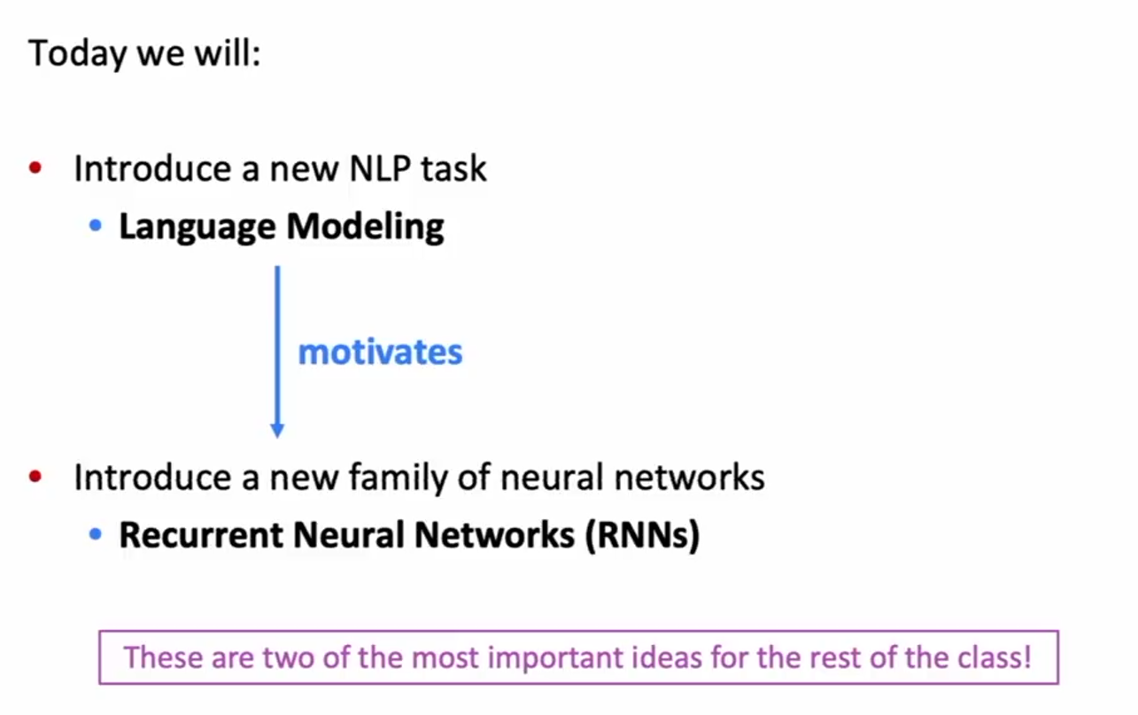
Language Models and RNNs
Overview

Slide 3
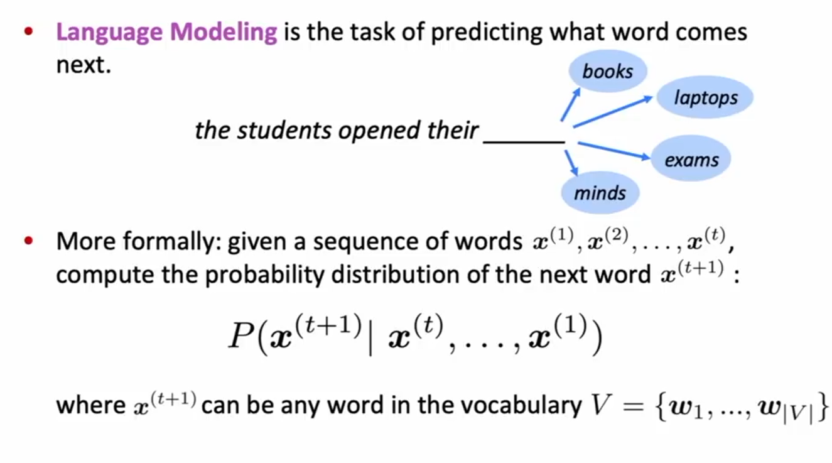
Language Modeling

Slide 4
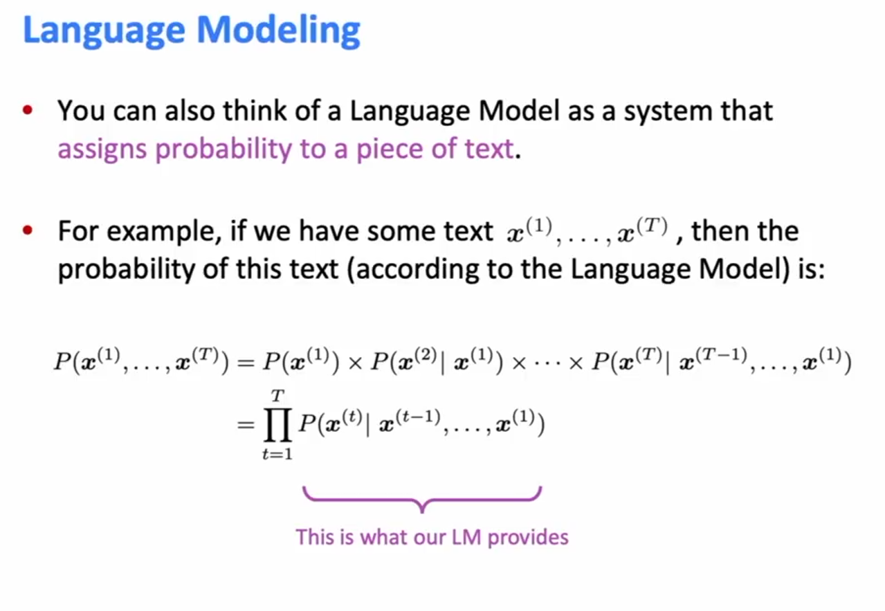
Language Modeling

Slide 5
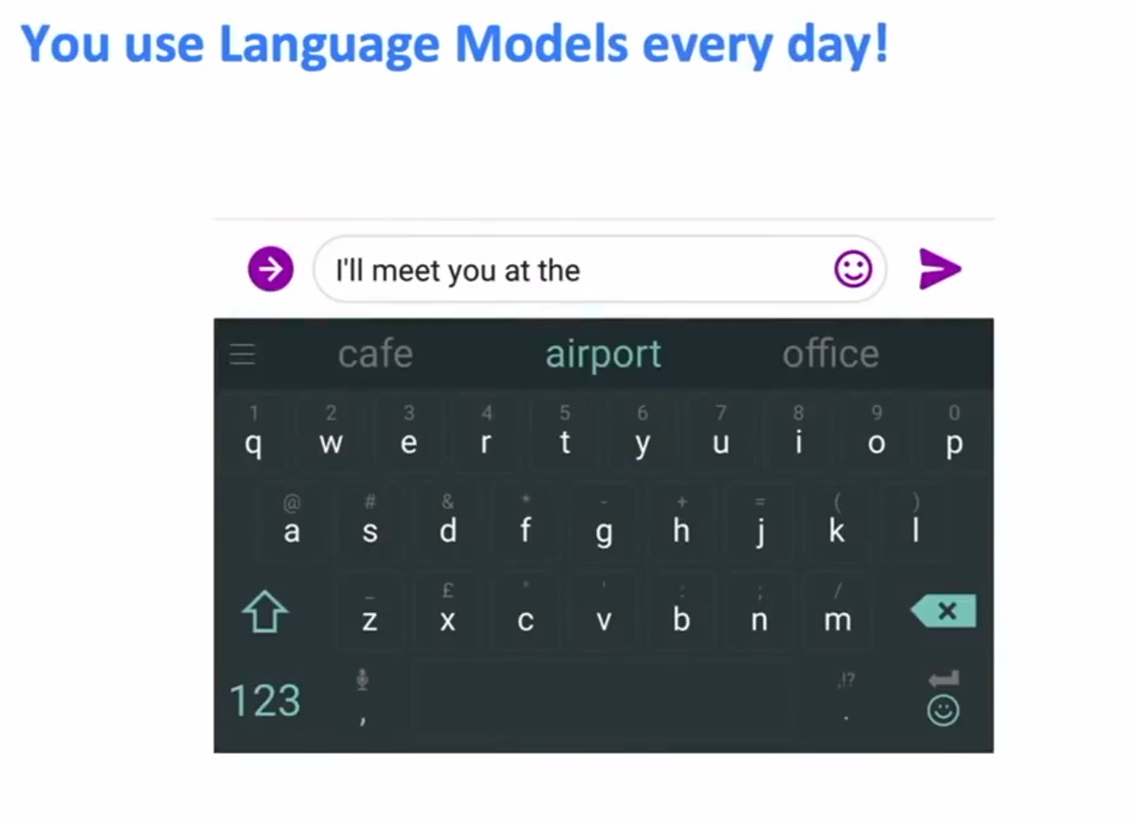
You use Language Models every day

Slide 6

You use Language Models every day

Slide 7
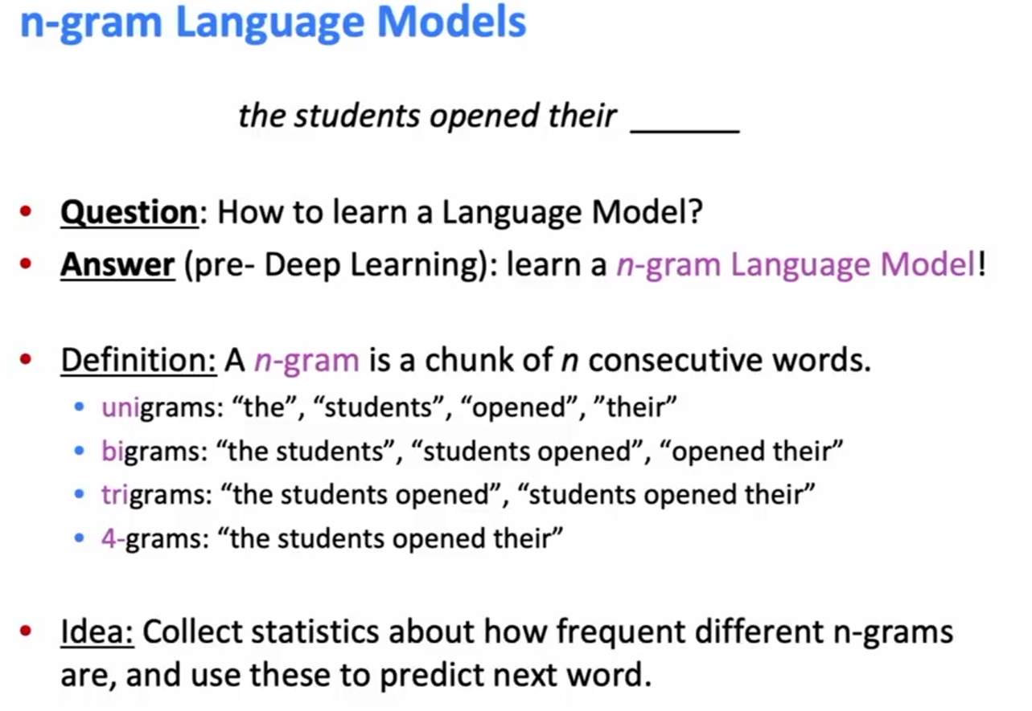
n-gram Language Models

Slide 8
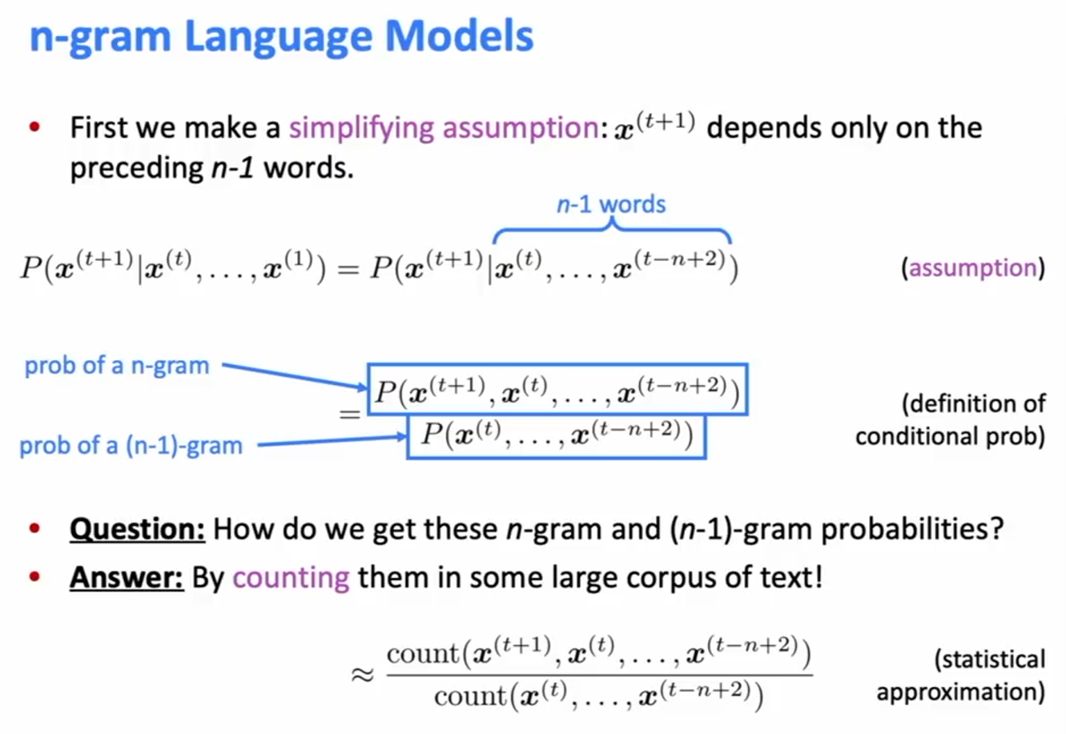
n-gram Language Models

Slide 9
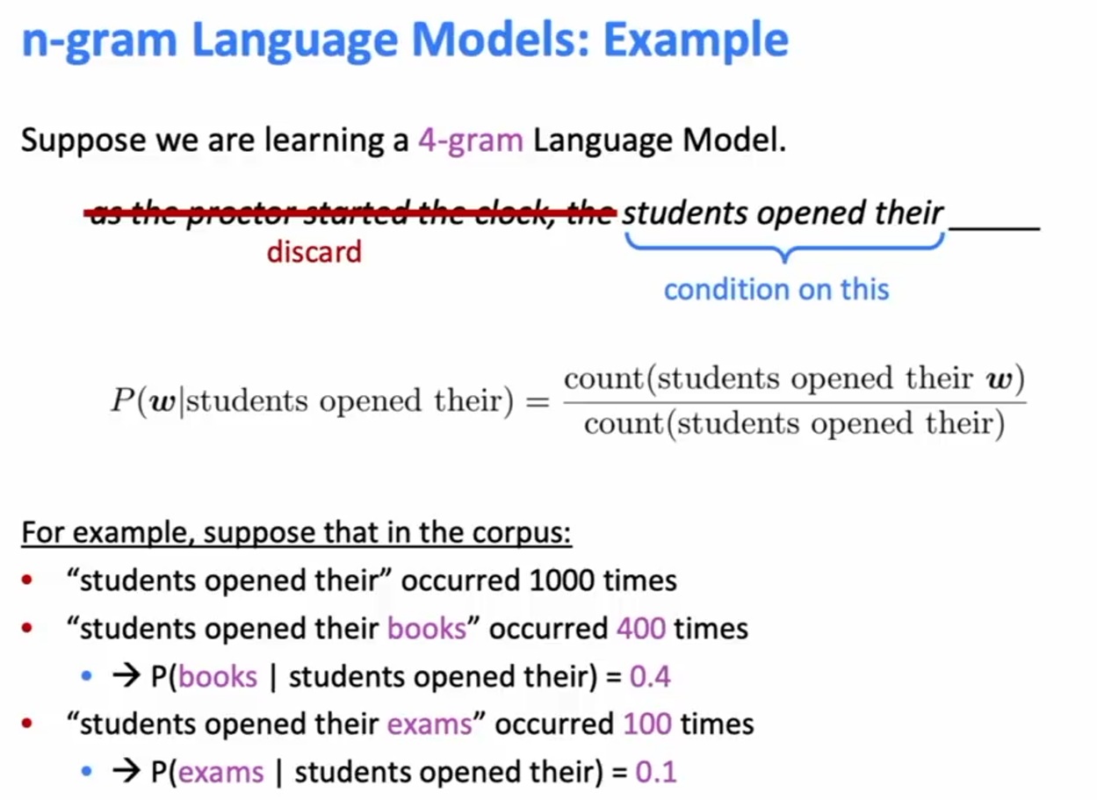
n-gram Language Models: Example

Slide 10
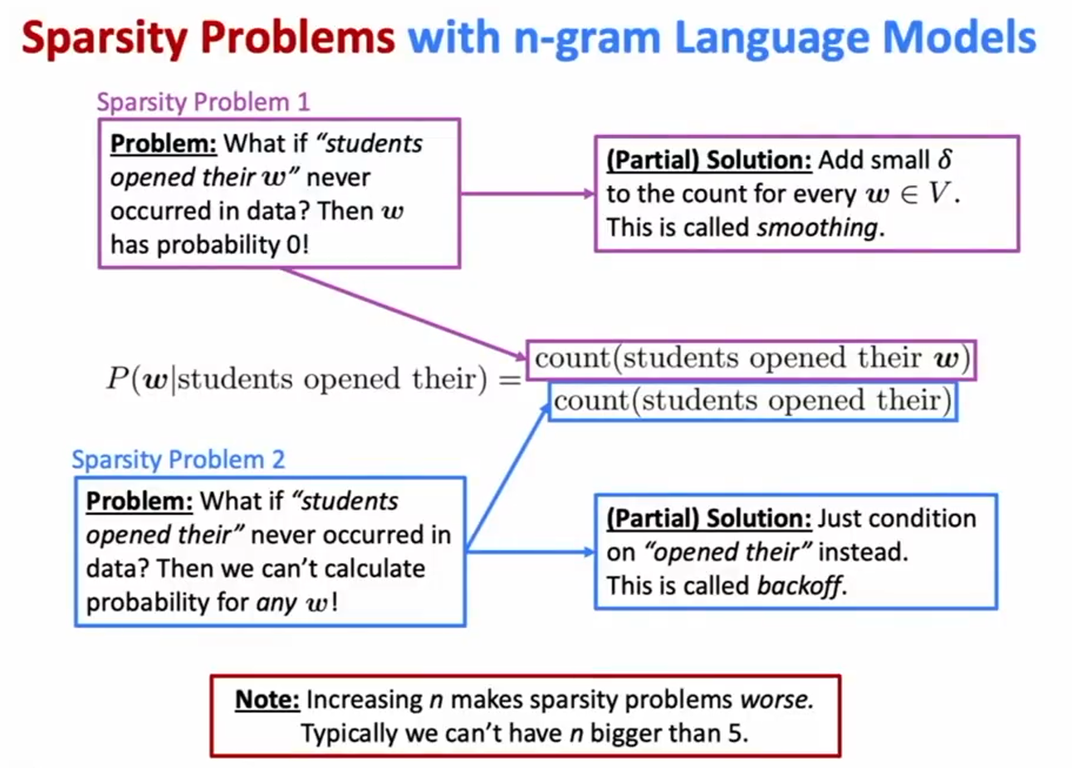
Sparsity Problems with n-gram Language Models

Slide 11
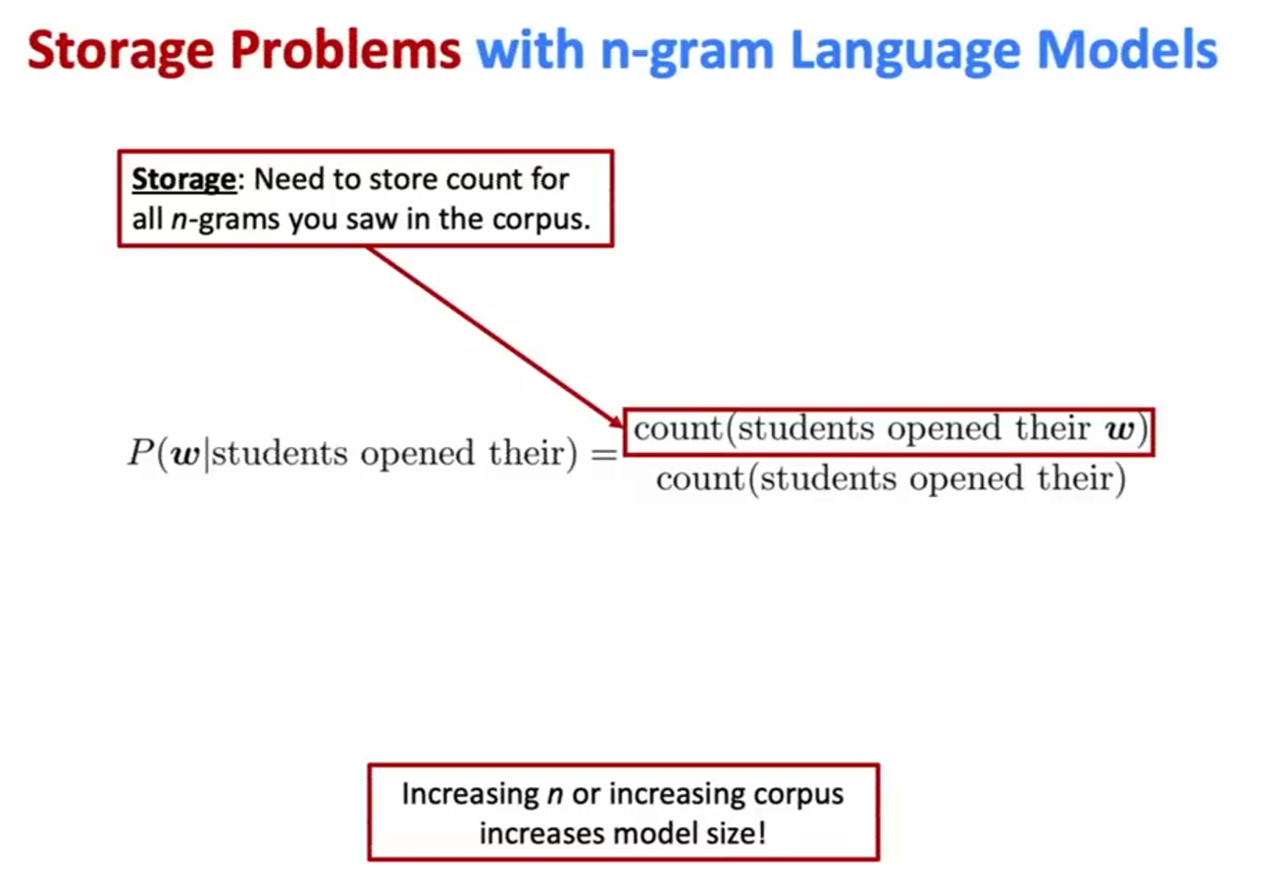
Storage Problems with n-gram Language Models

Slide 12
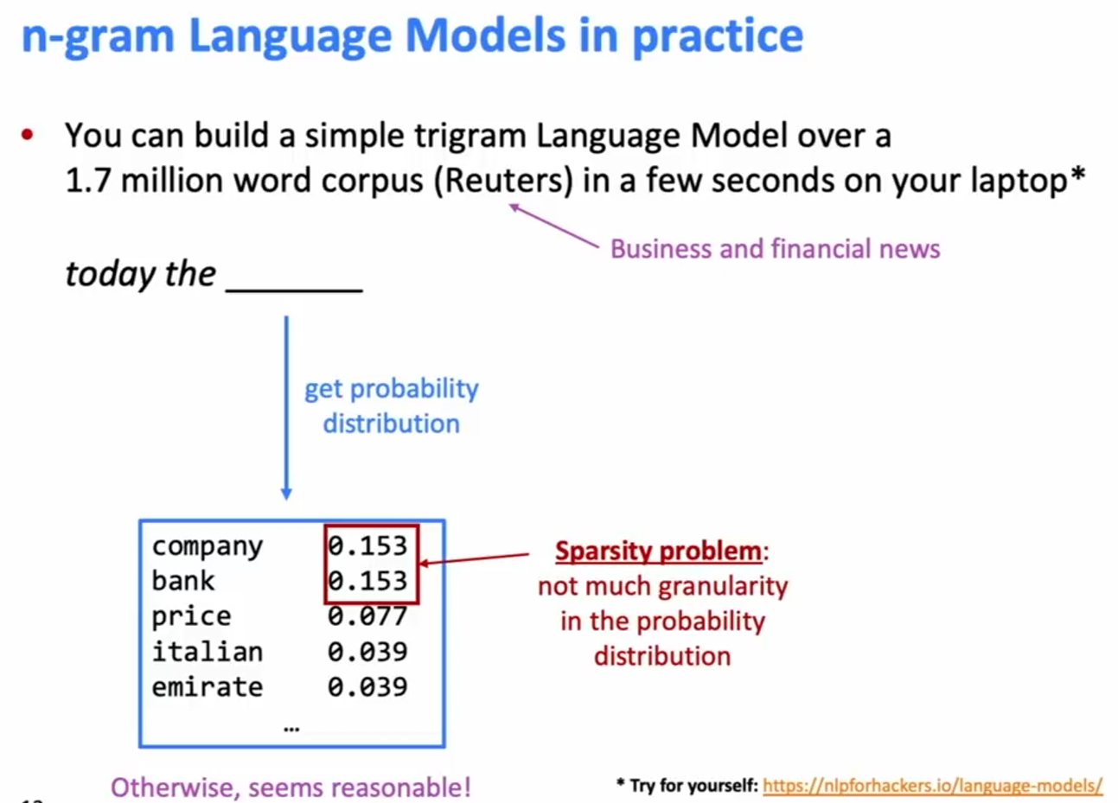
n-gram Language Models in practice

Slide 13
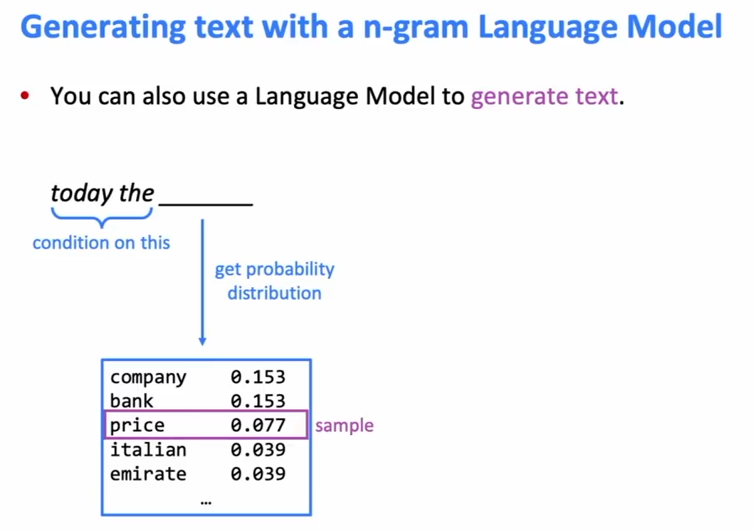
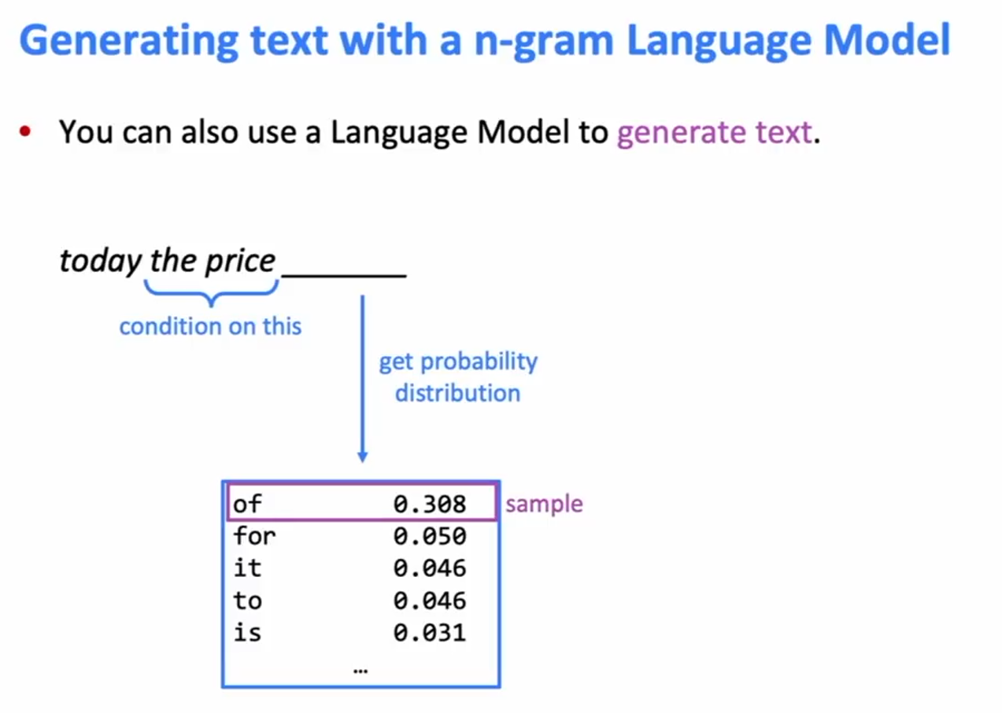
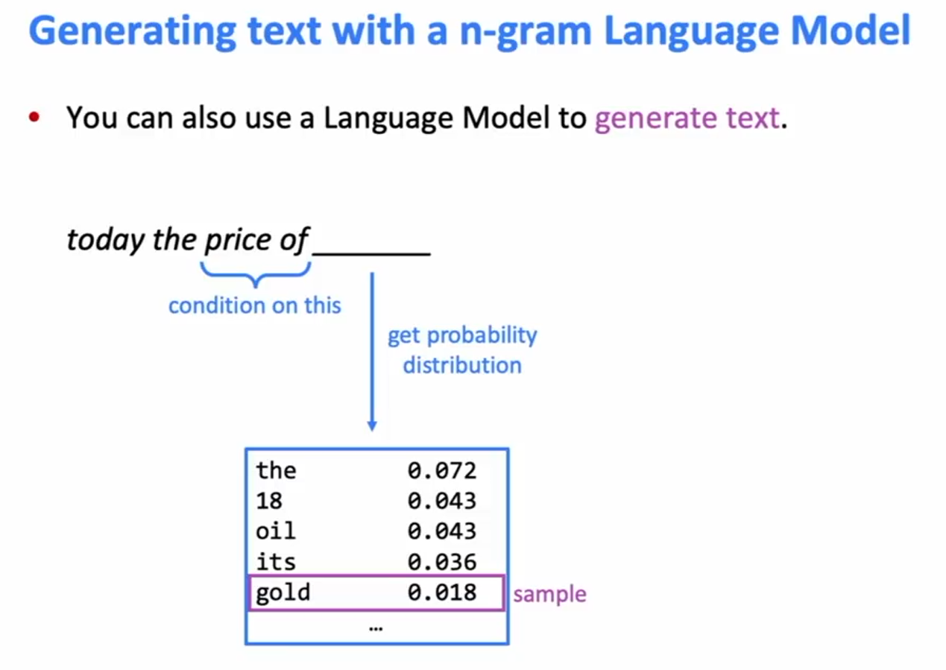
Generating text with a n-gram Language Model

Slide 14
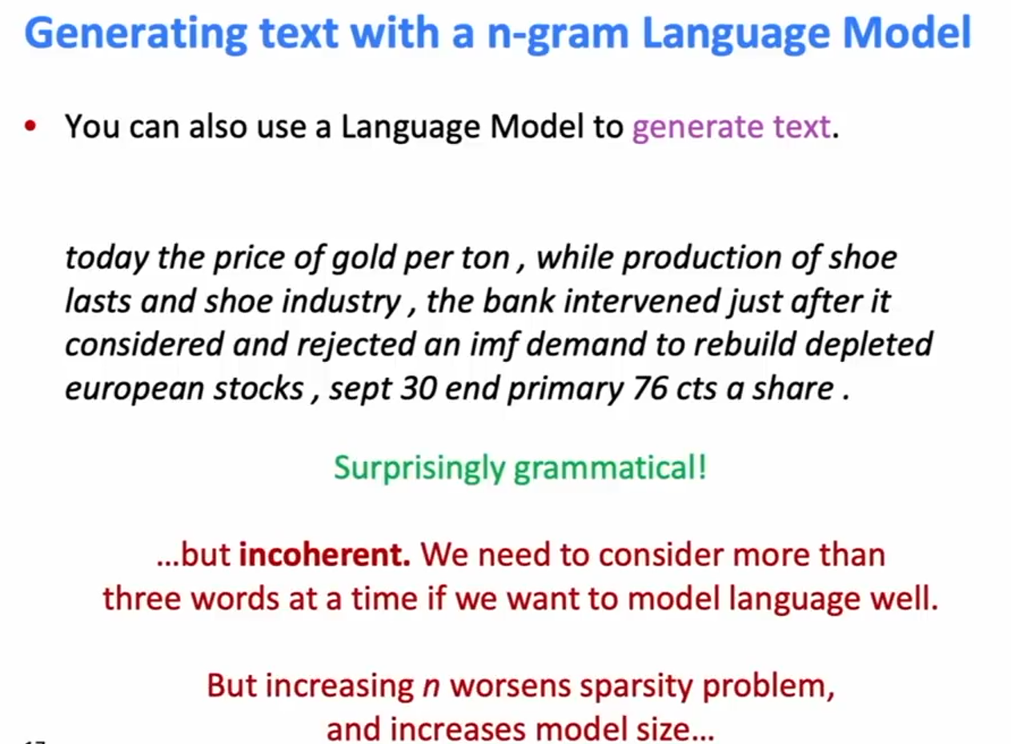
Generating text with a n-gram Language Model

Slide 15
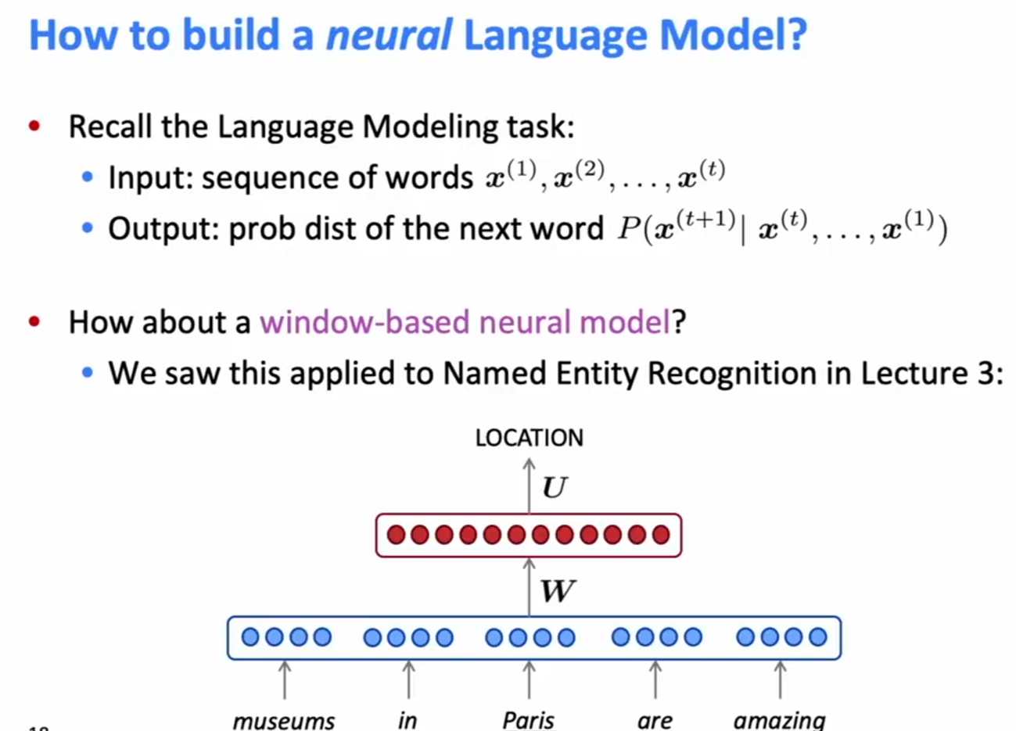
How to build a Neural Language Model

Slide 16
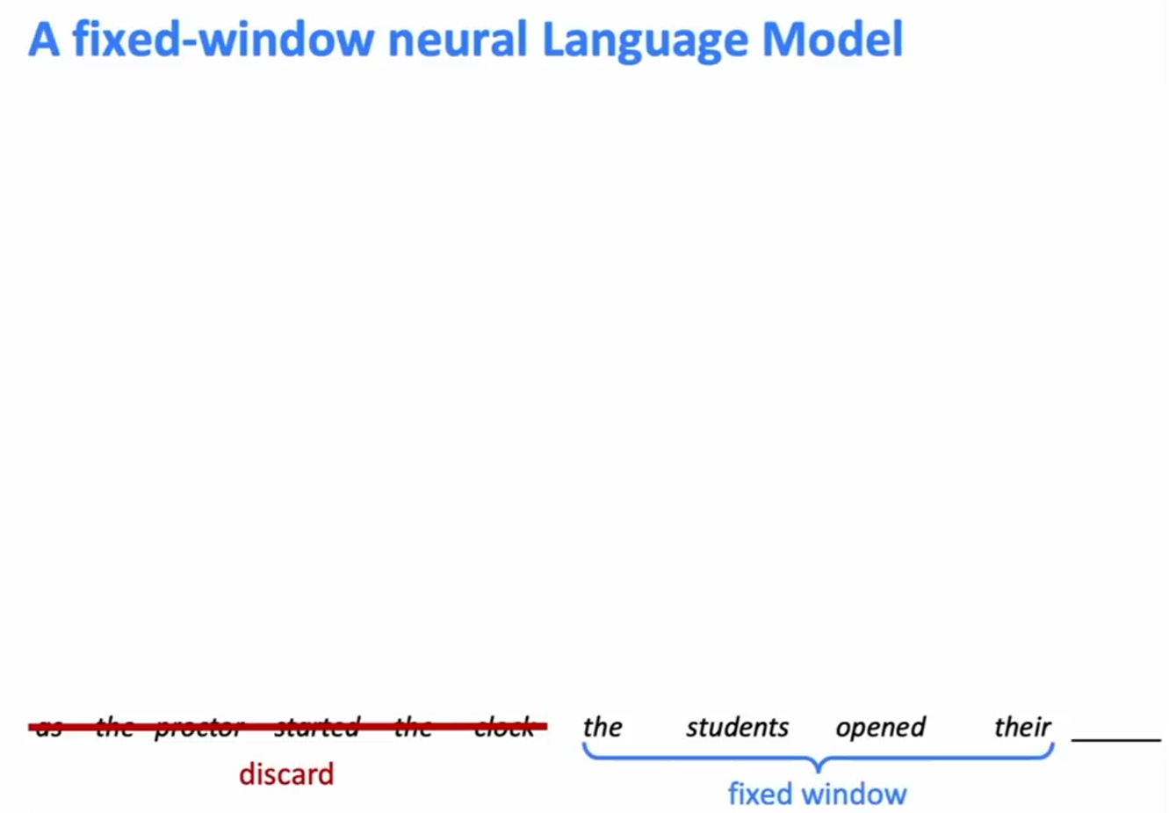
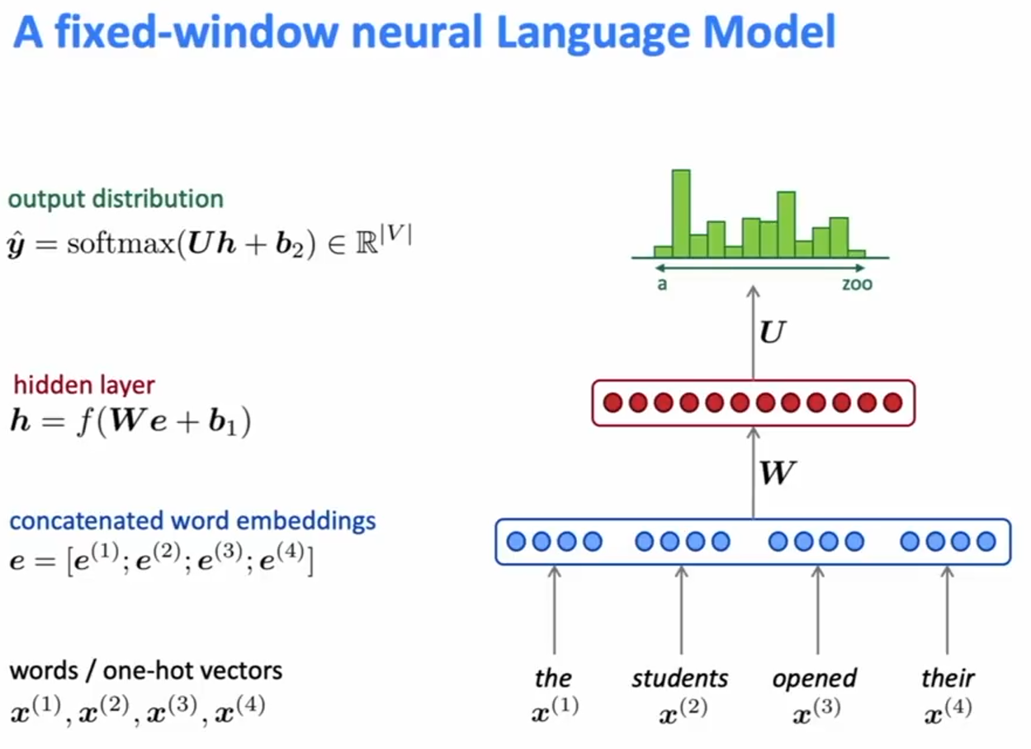
A fixed-window neural Language Model

Slide 17
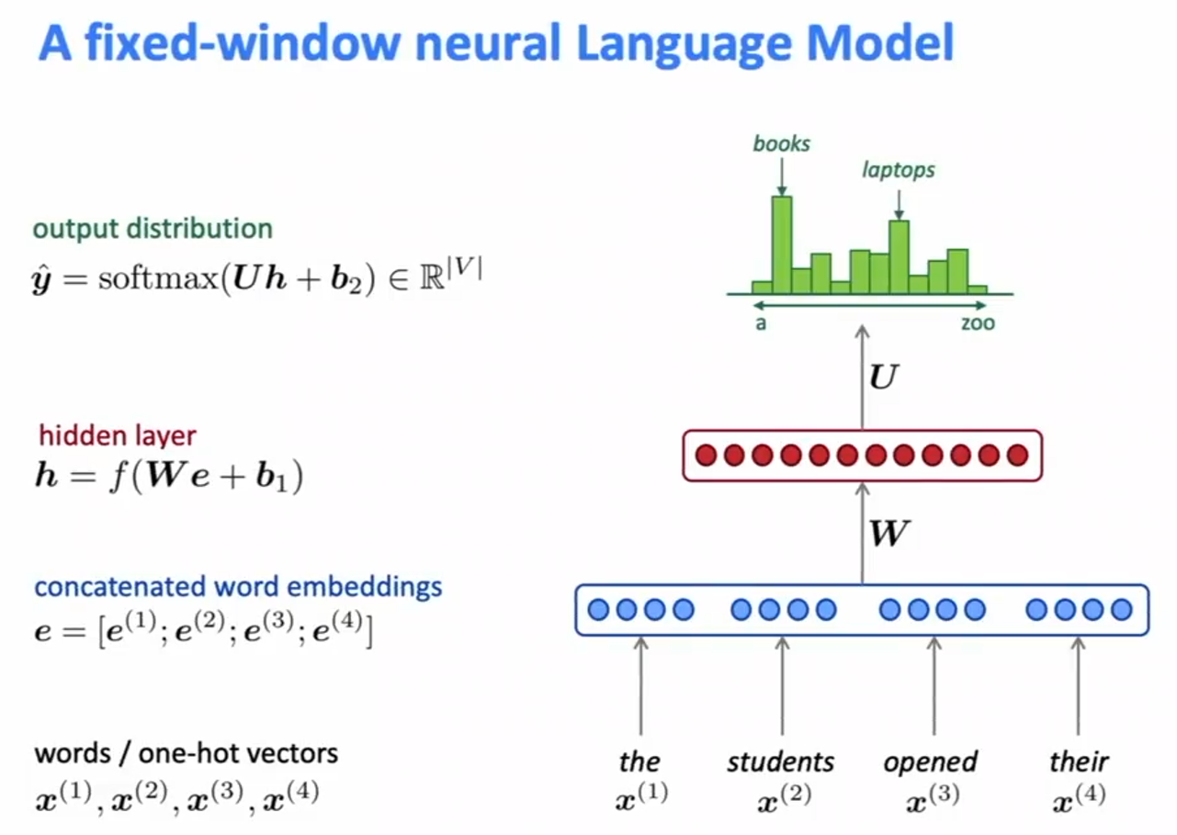
A Fixed-window neural Language Model

Slide 18
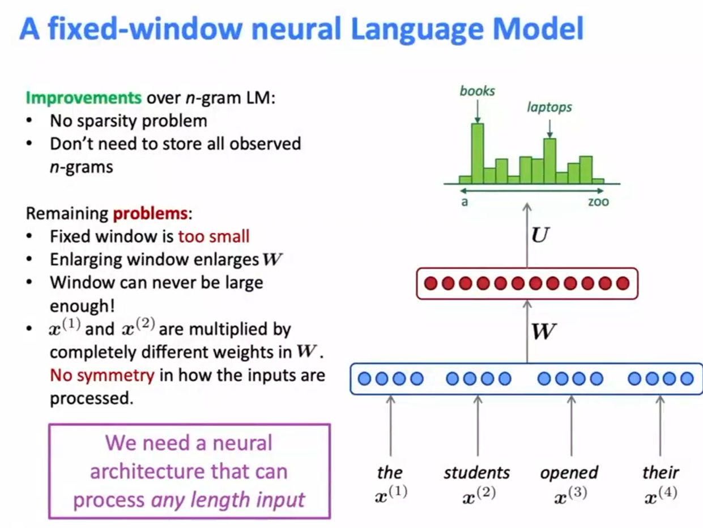
A fixed-window neural Language Model

Slide 19
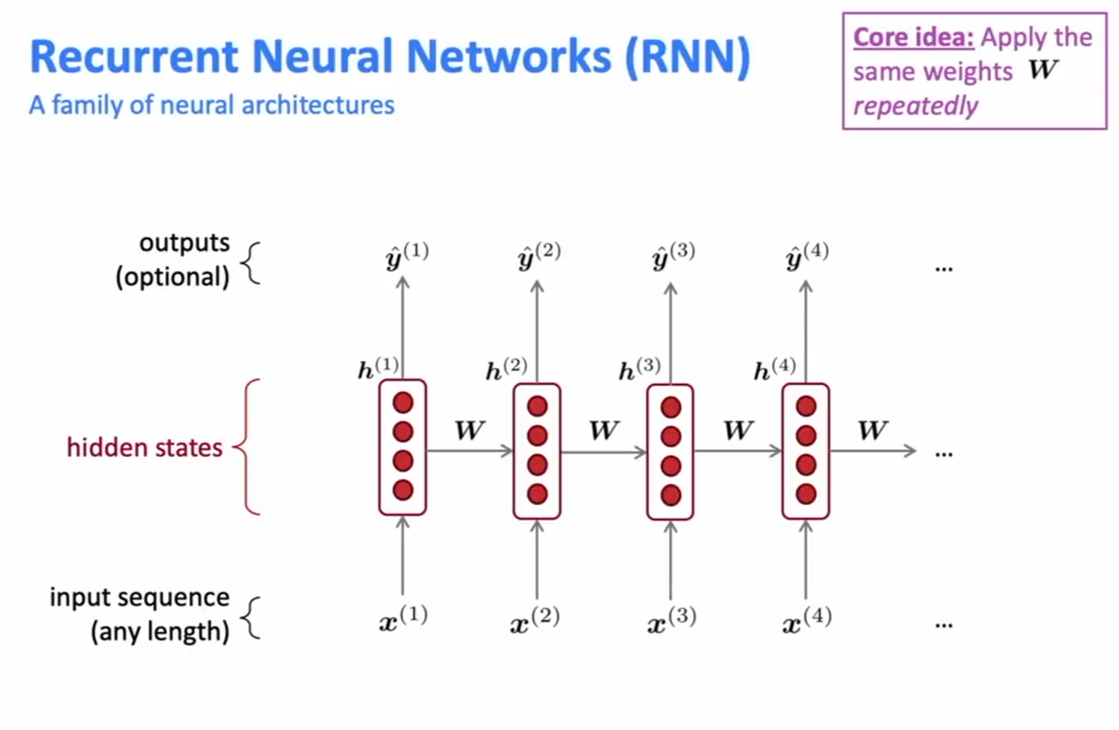
Recurrent Neural Networks (RNN) – A family of neural architectures

Slide 20
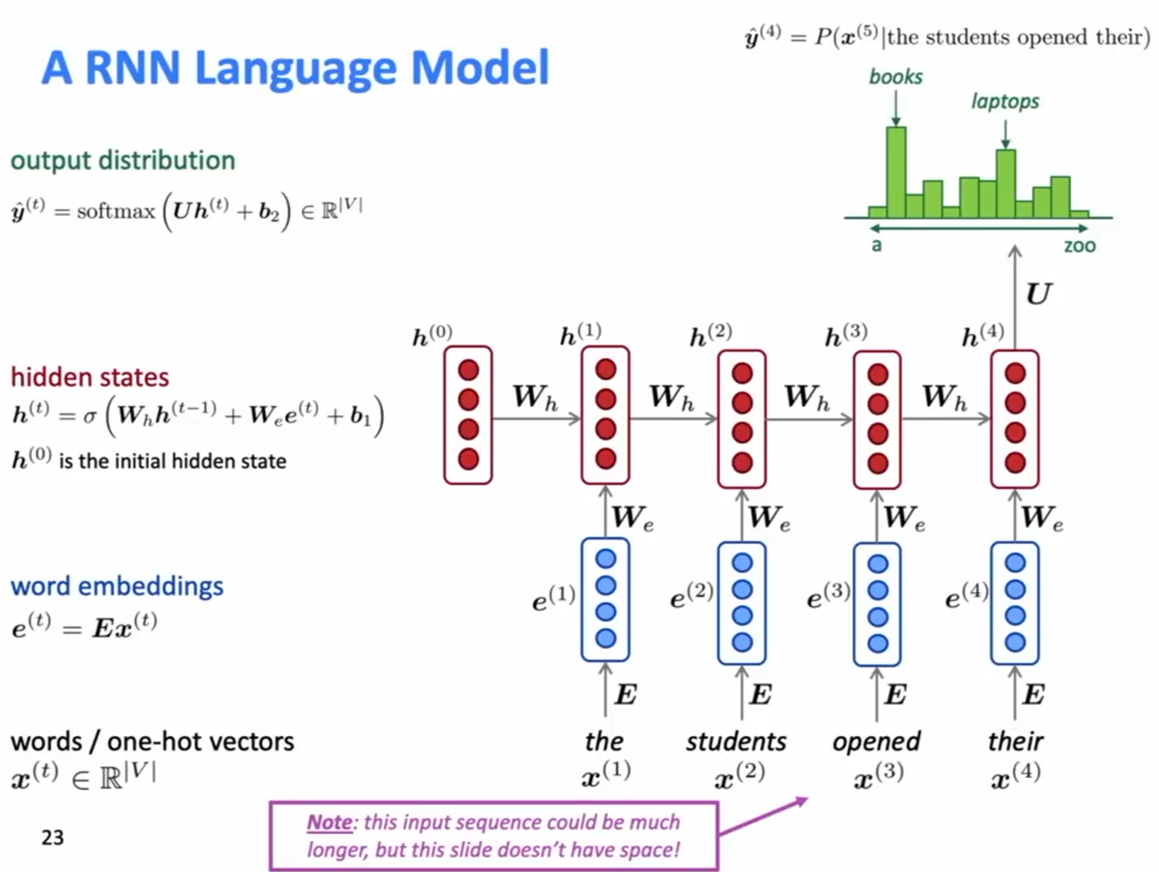
A RNN Language Model

Slide 21
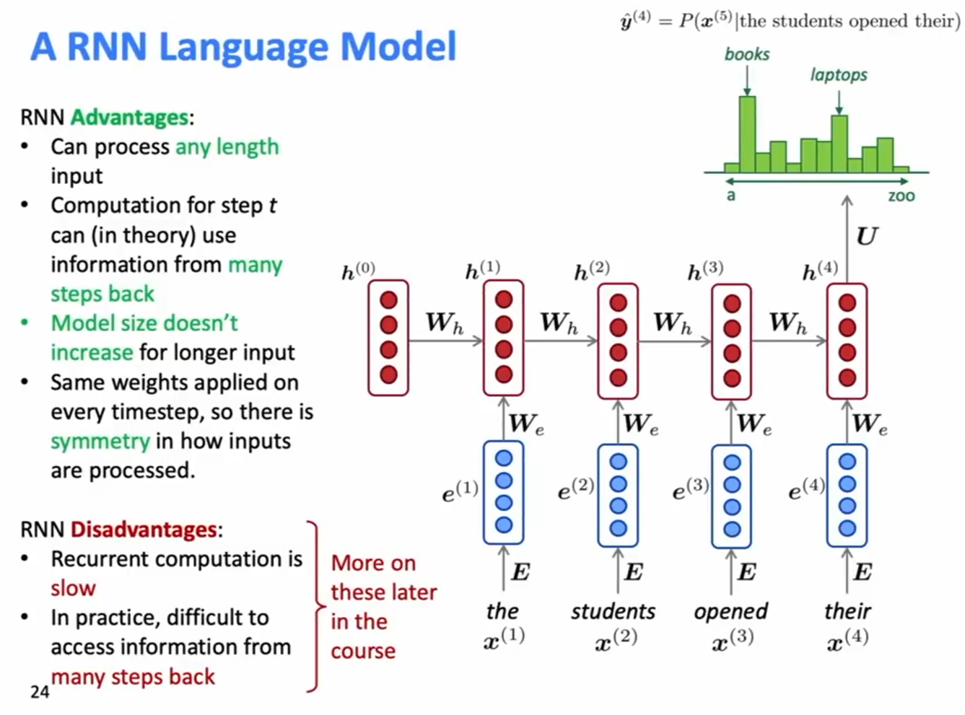
A RNN Language Model

Slide 22
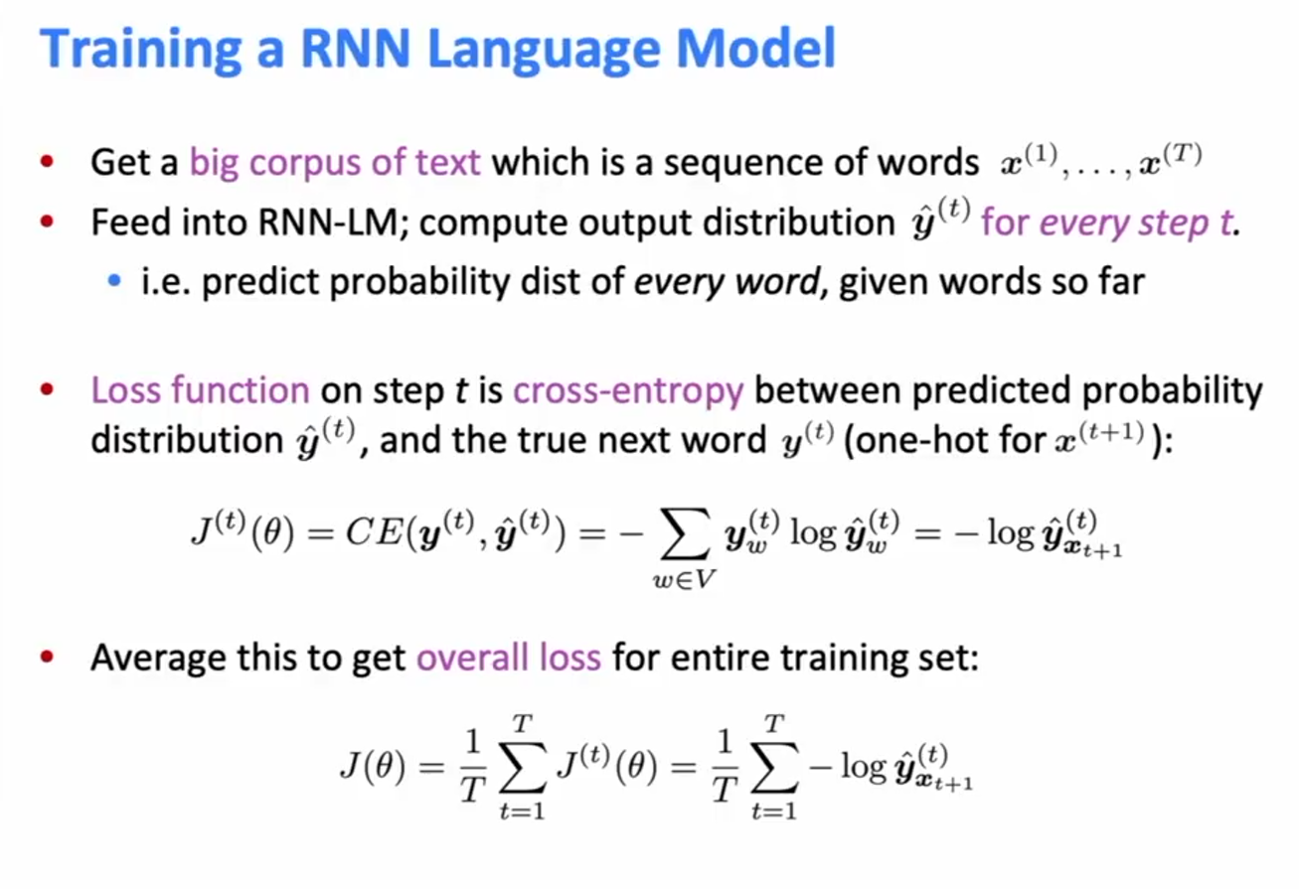
Training a RNN Language Model

Slide 23
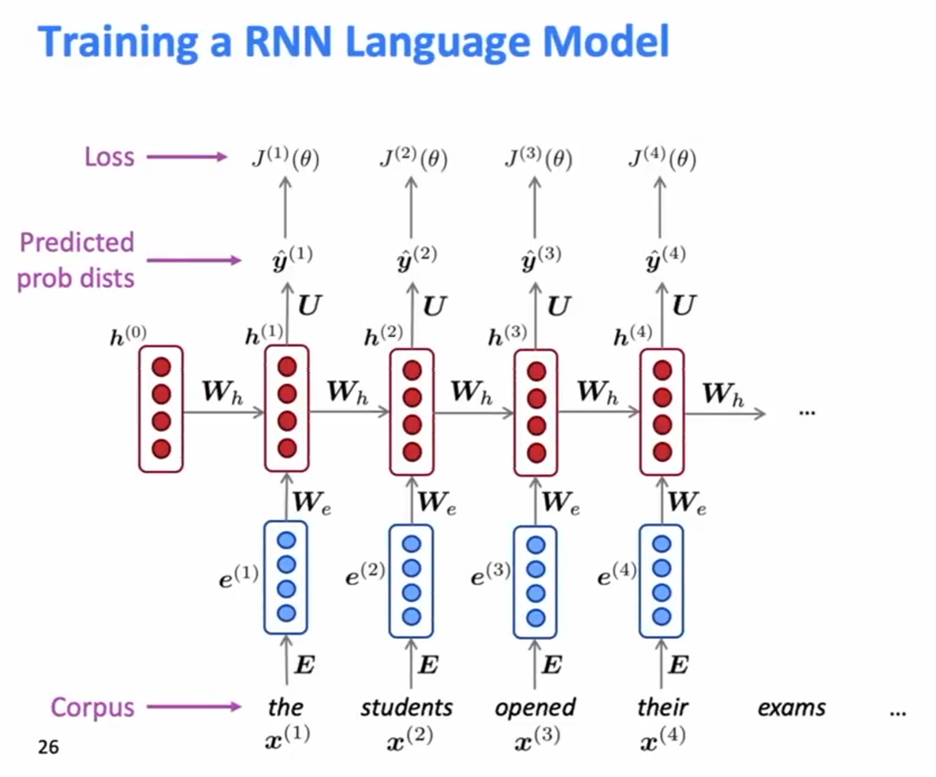
Training a RNN Language Model

Slide 24
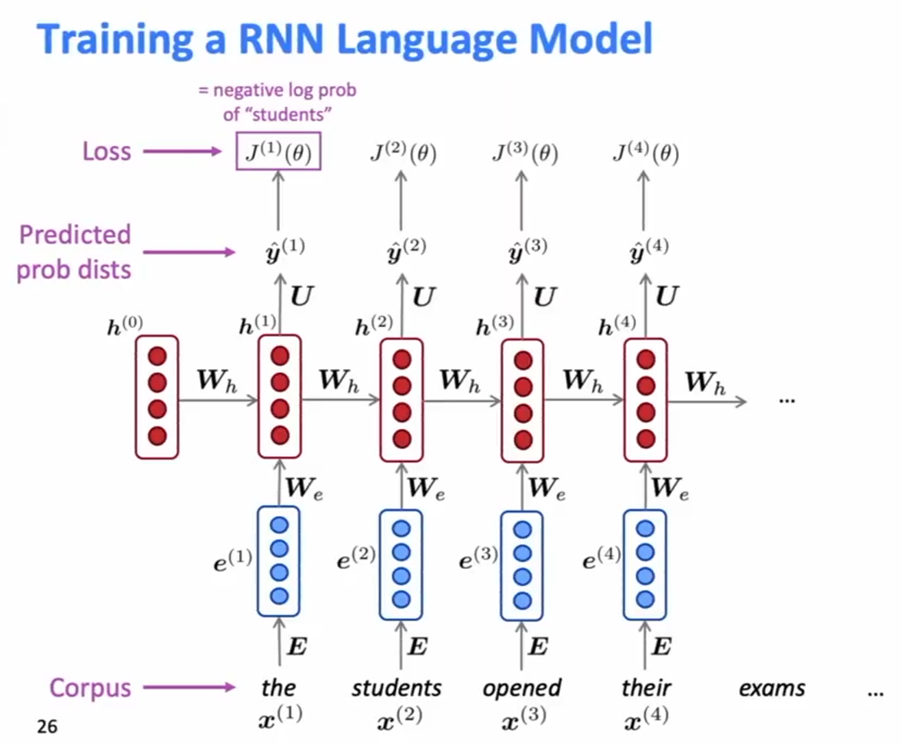
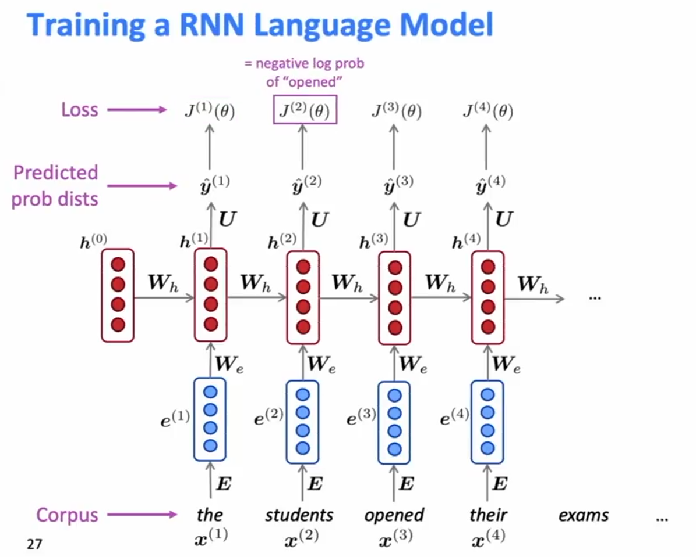
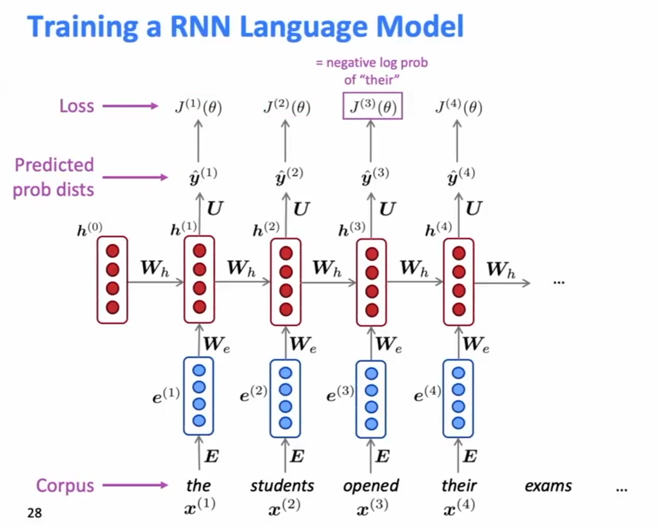
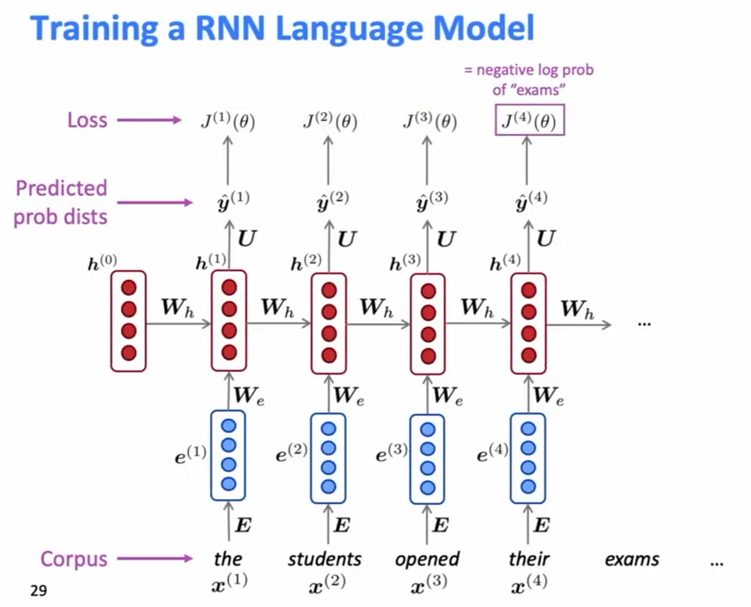
Training a RNN Language Model

Slide 25
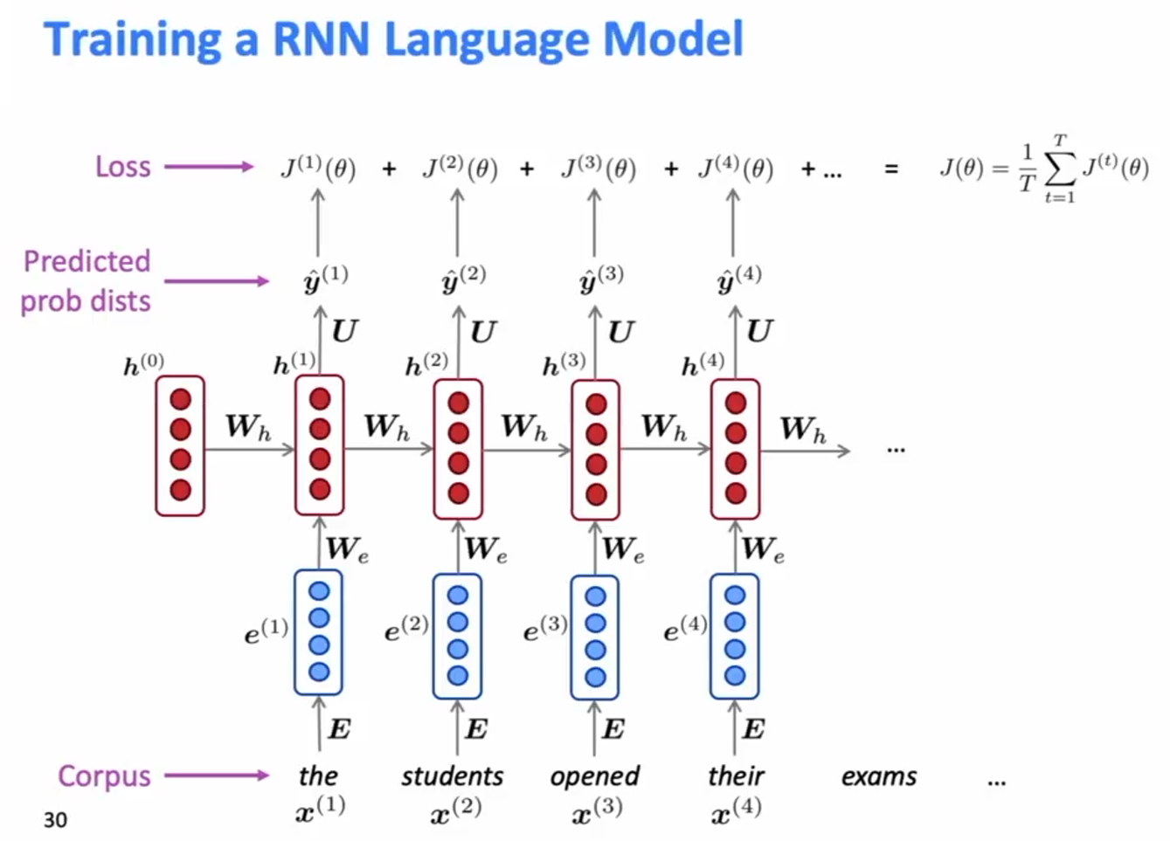
Training a RNN Language Model

Slide 26
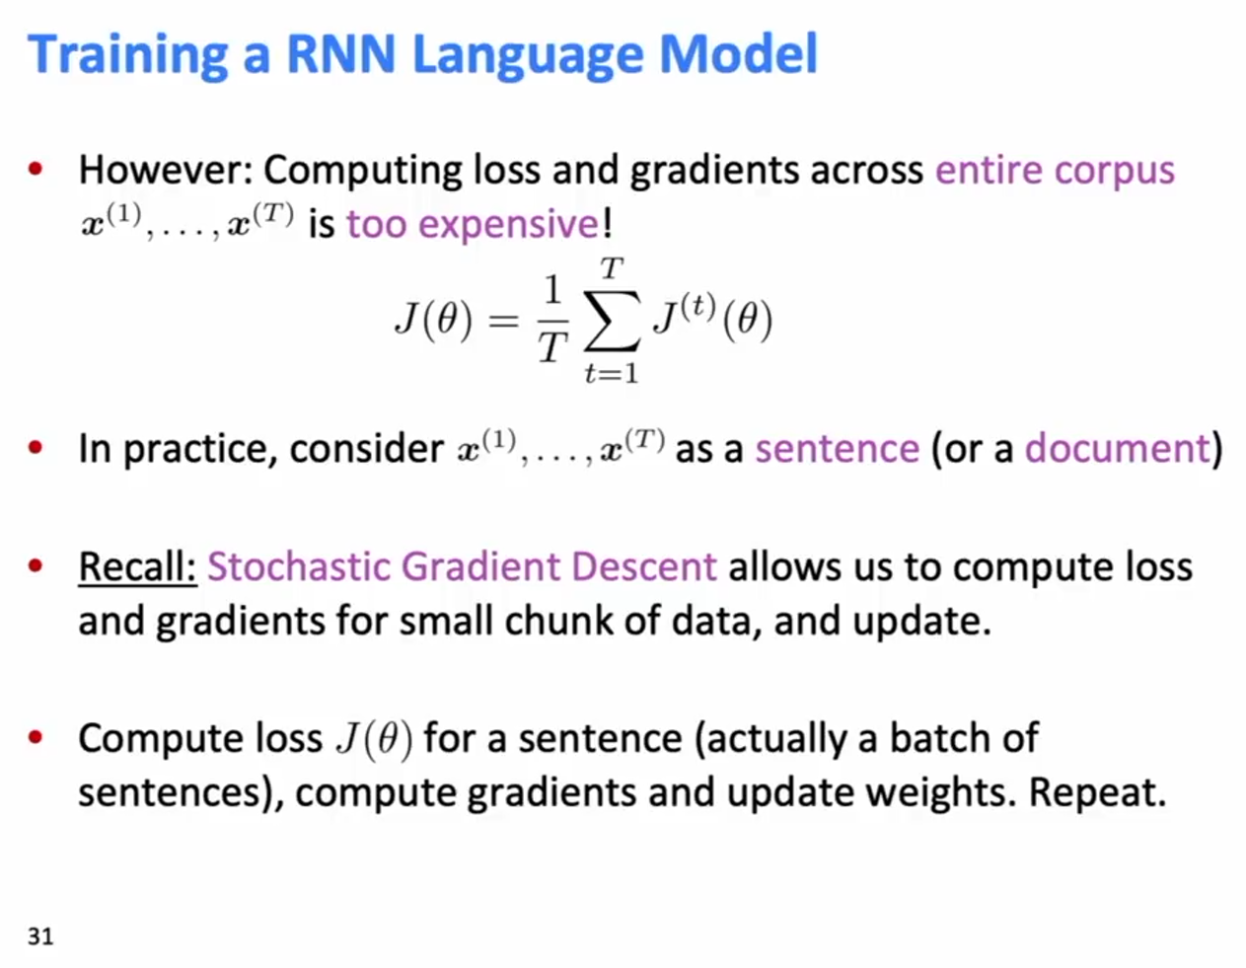
Training a RNN Language Model

Slide 27
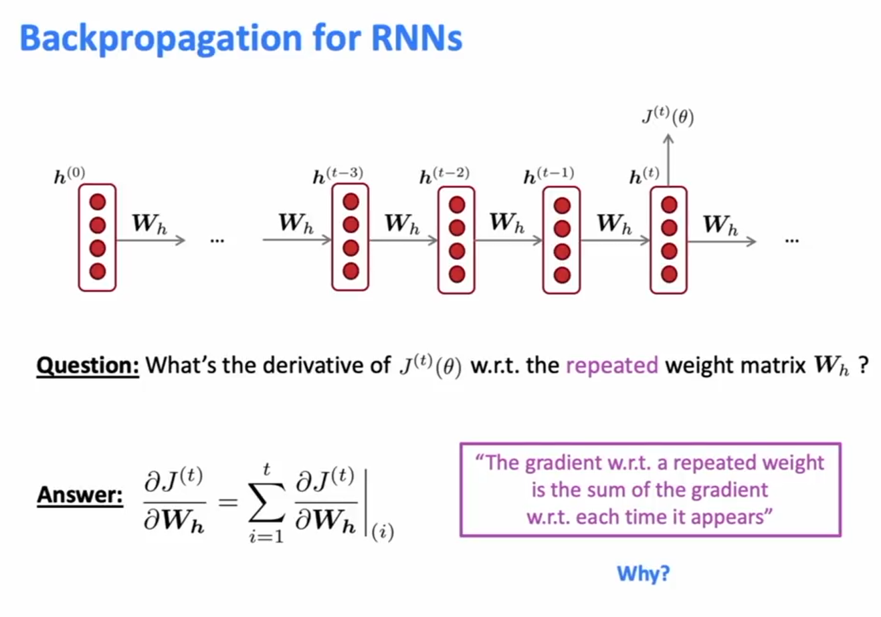
Backpropagation for RNNs

Slide 28
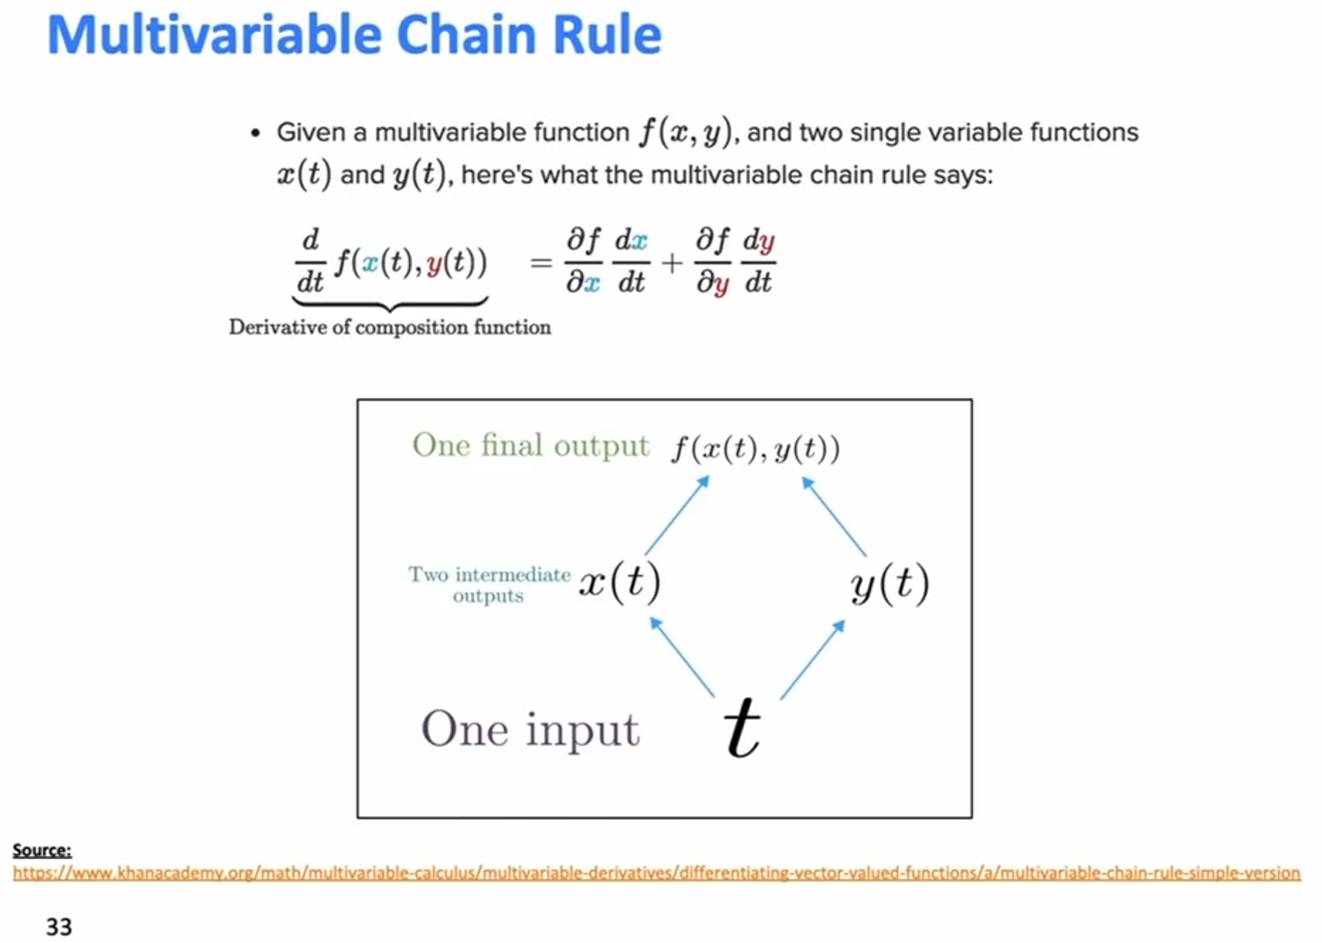
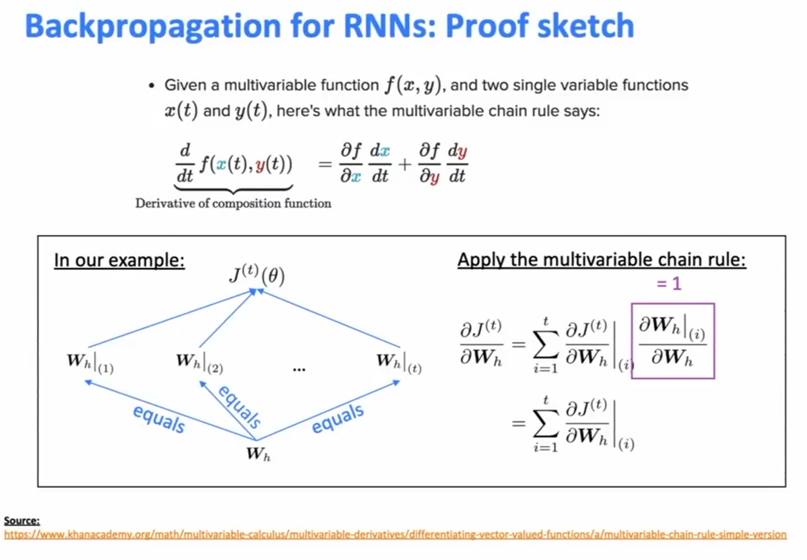
Backpropagation for RNNs

Slide 29
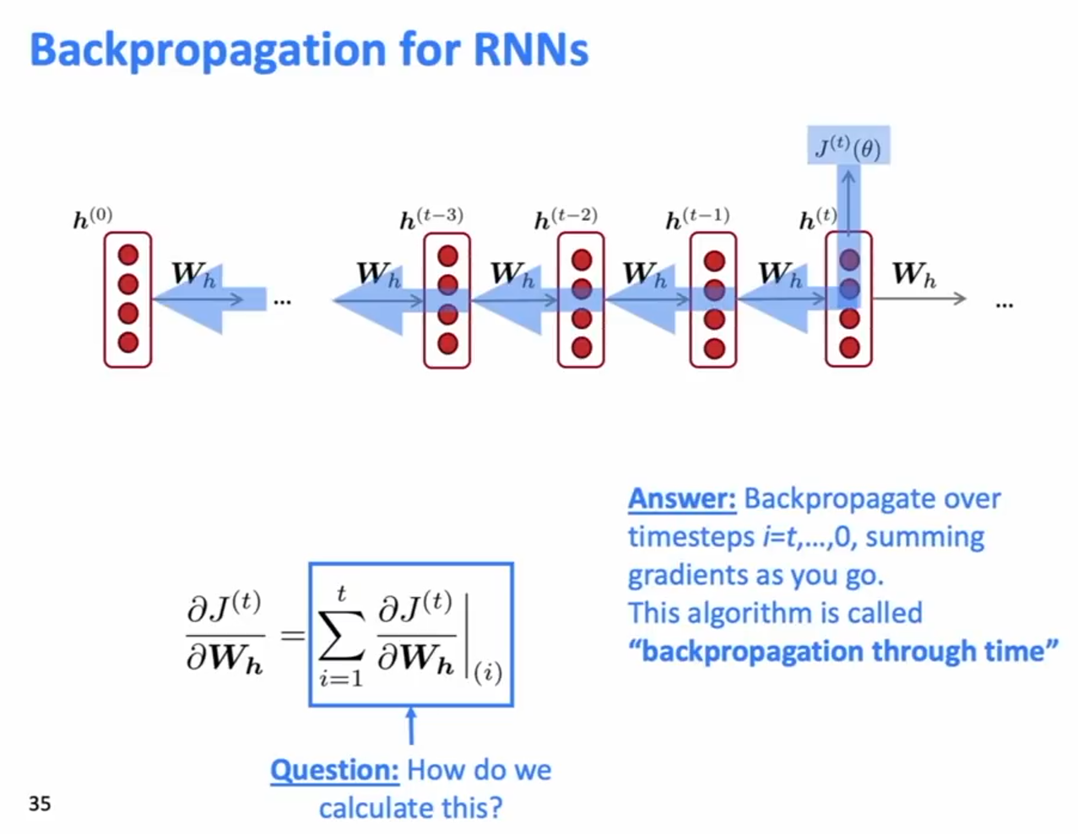
Backpropagation for RNNs

Slide 30
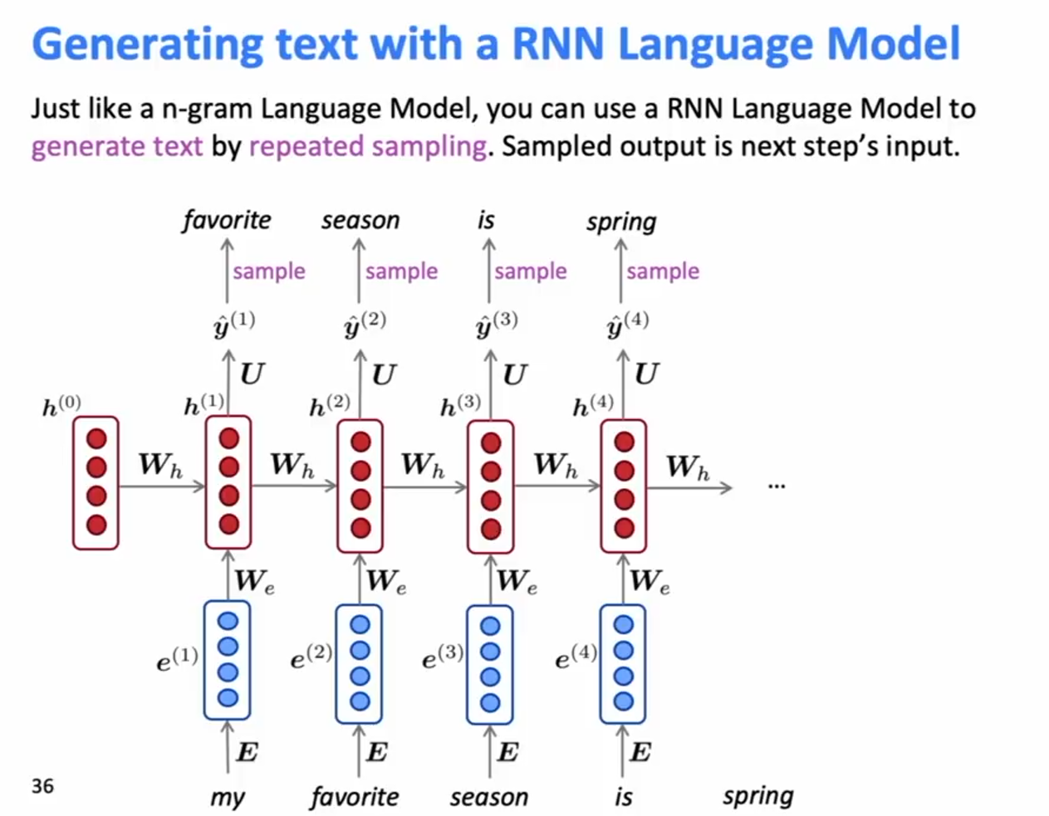
Generating text with a RNN Language Model

Slide 31
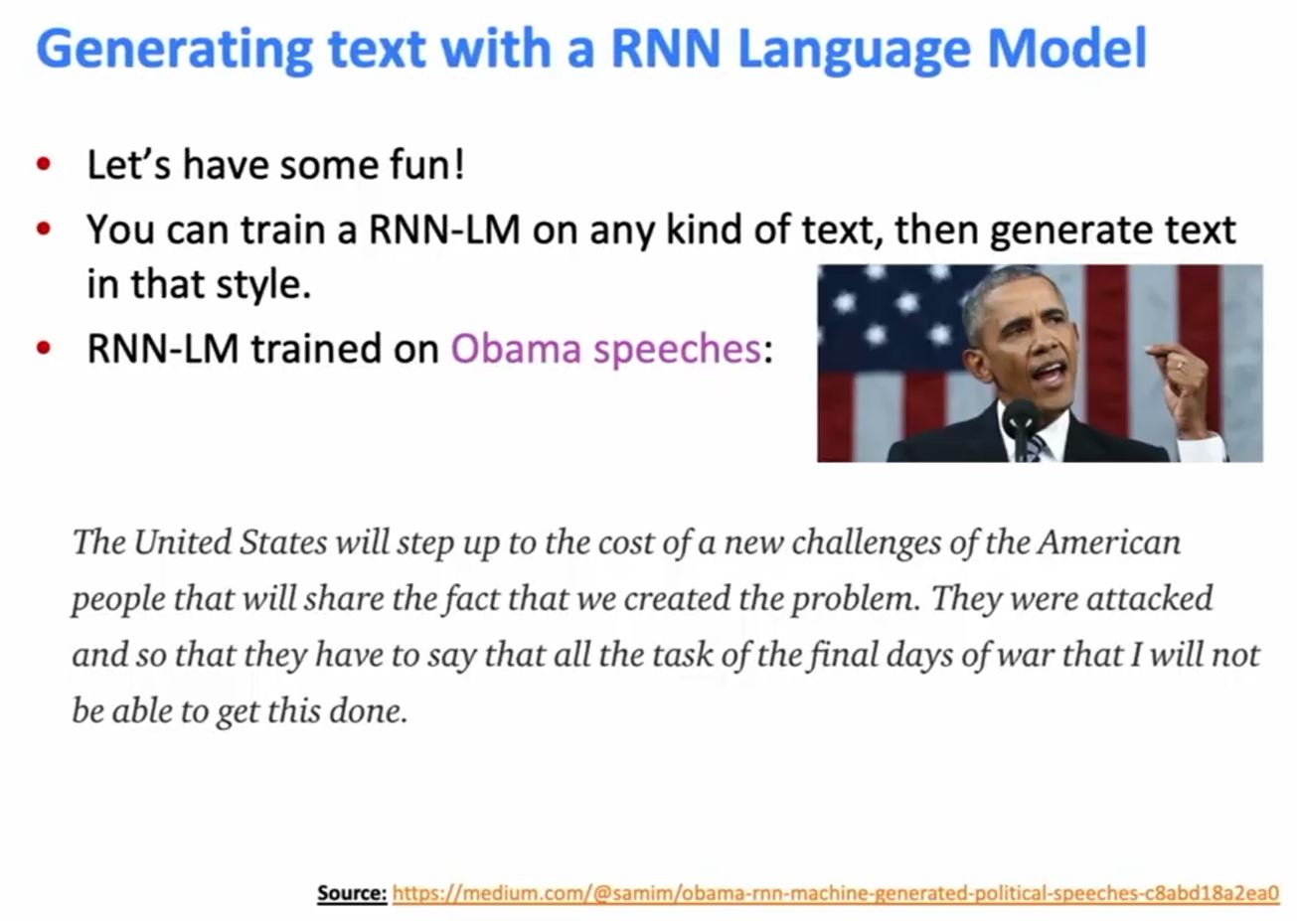
Generating text with a RNN Language Model

Slide 32
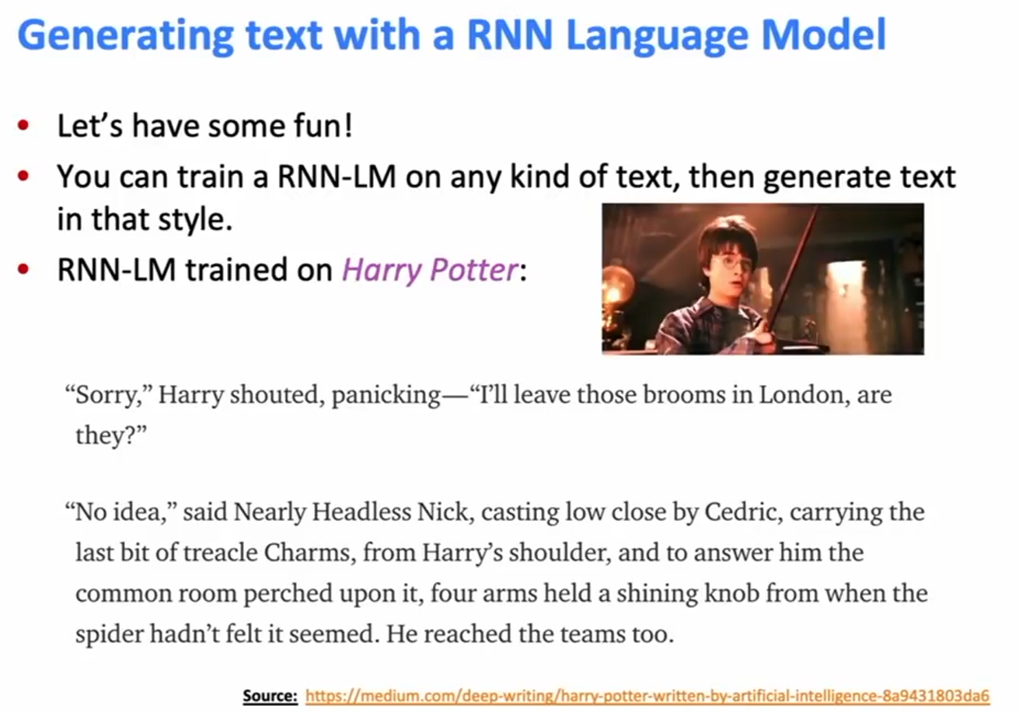
Generating text with a RNN Language Model

Slide 33
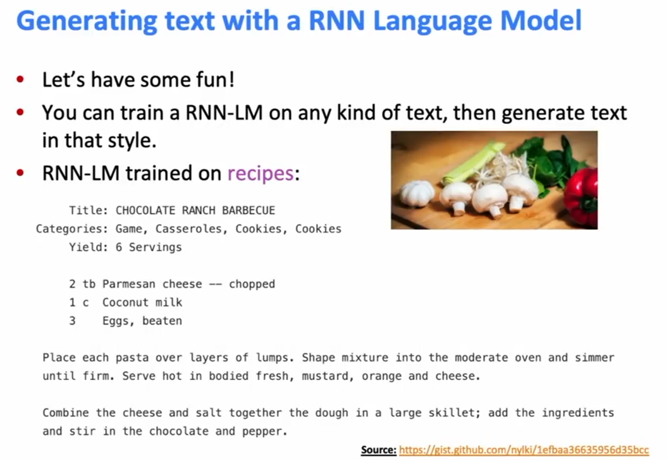
Generating text with a RNN Language Model

Slide 34
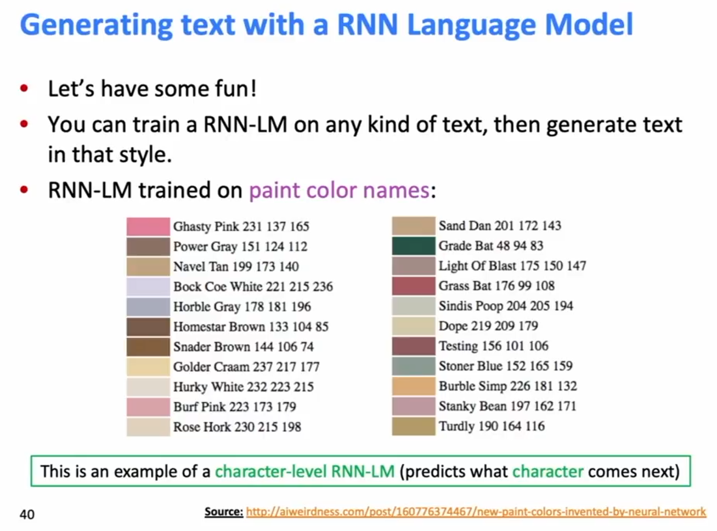
Generating text with a RNN Language Model

Slide 35
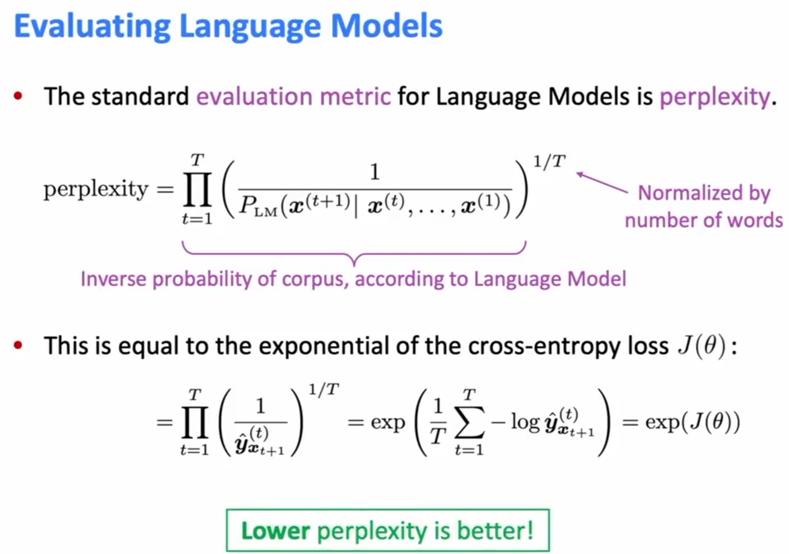
Evaluating Language Models

Slide 36
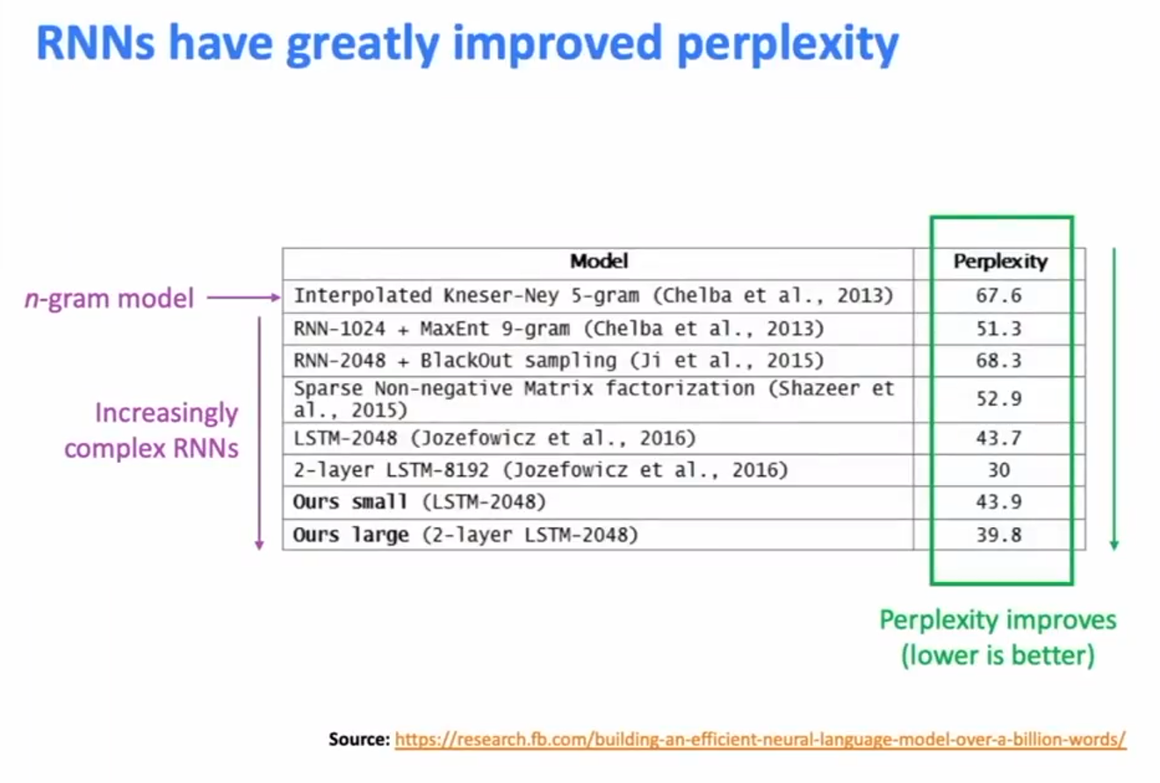
RNNs have greatly improved perplexity

Slide 37
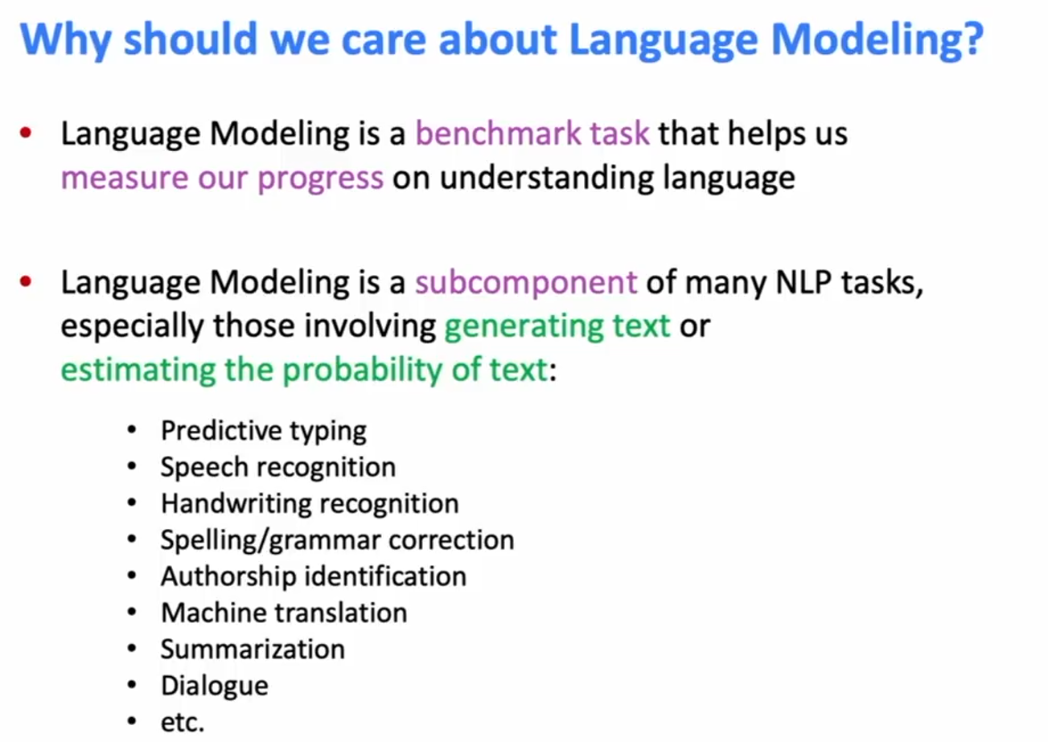
Why should we care about Language Modelling

Slide 38
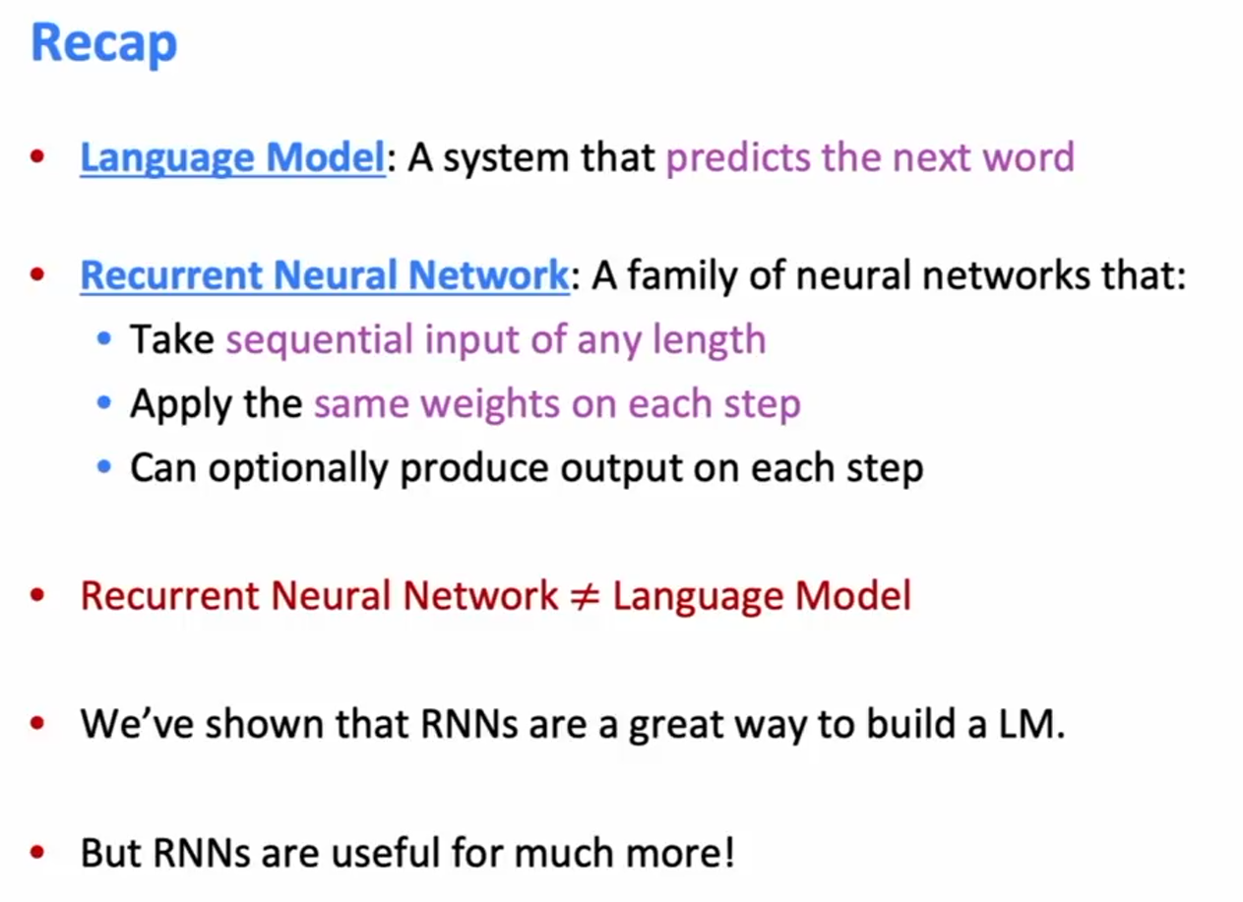
Recap

Slide 39
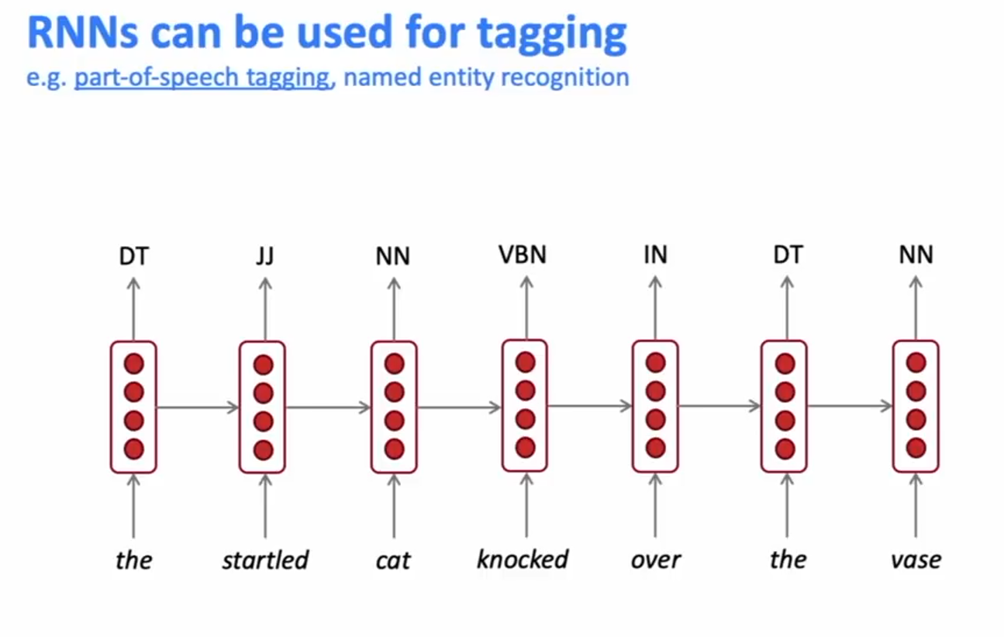
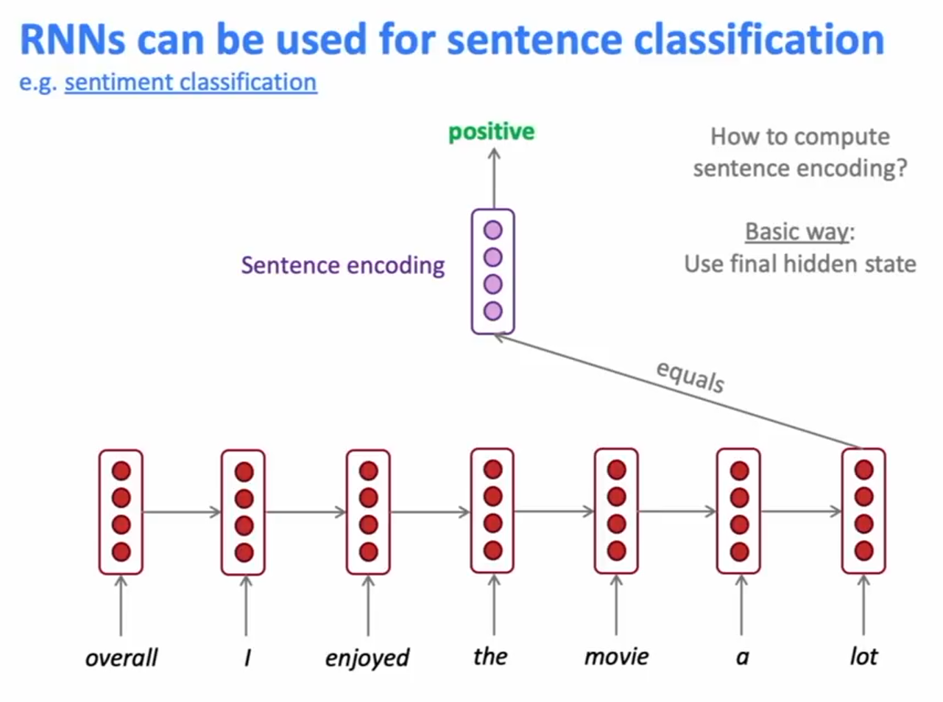
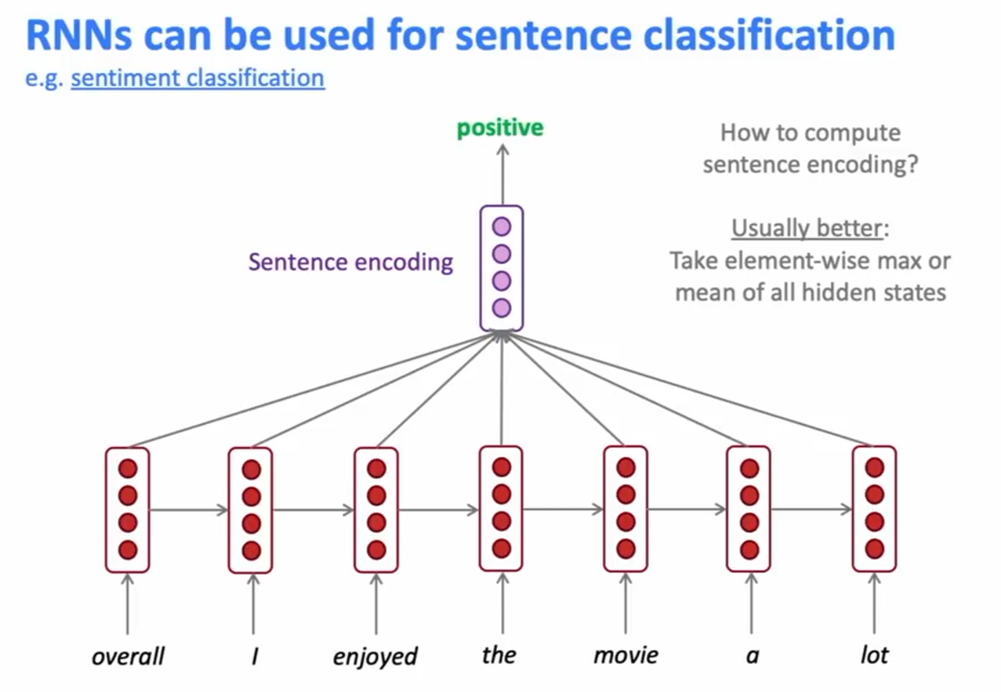
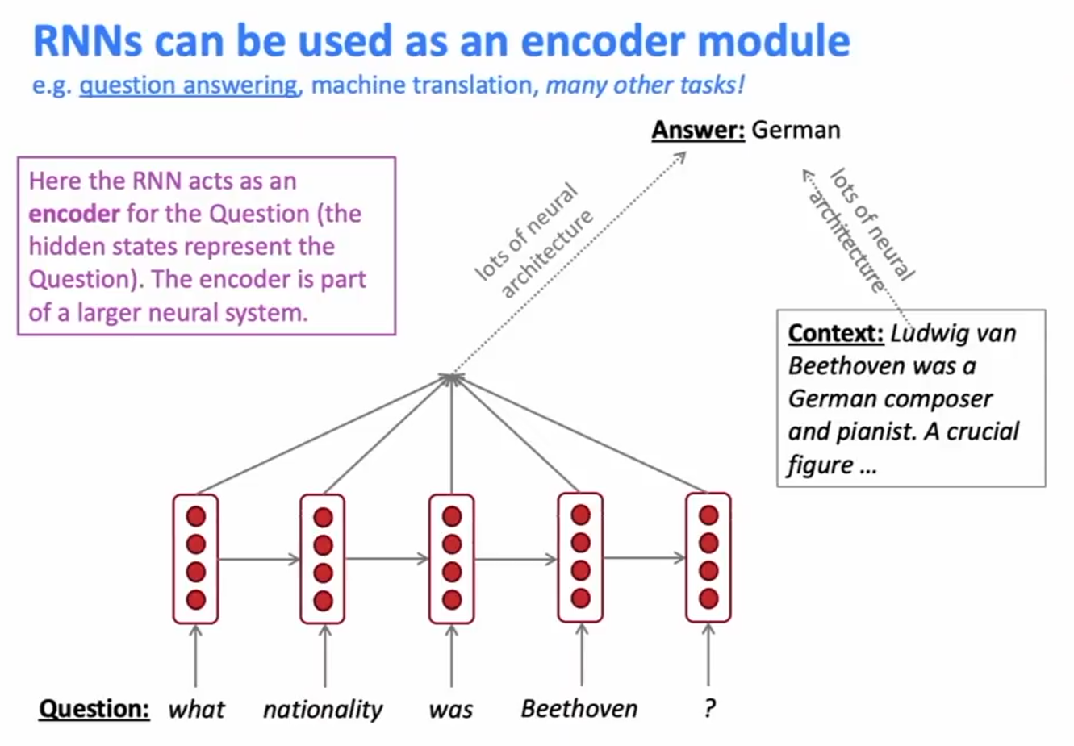
RNN – Other Use Cases – Beyond Language Modelling

Slide 40
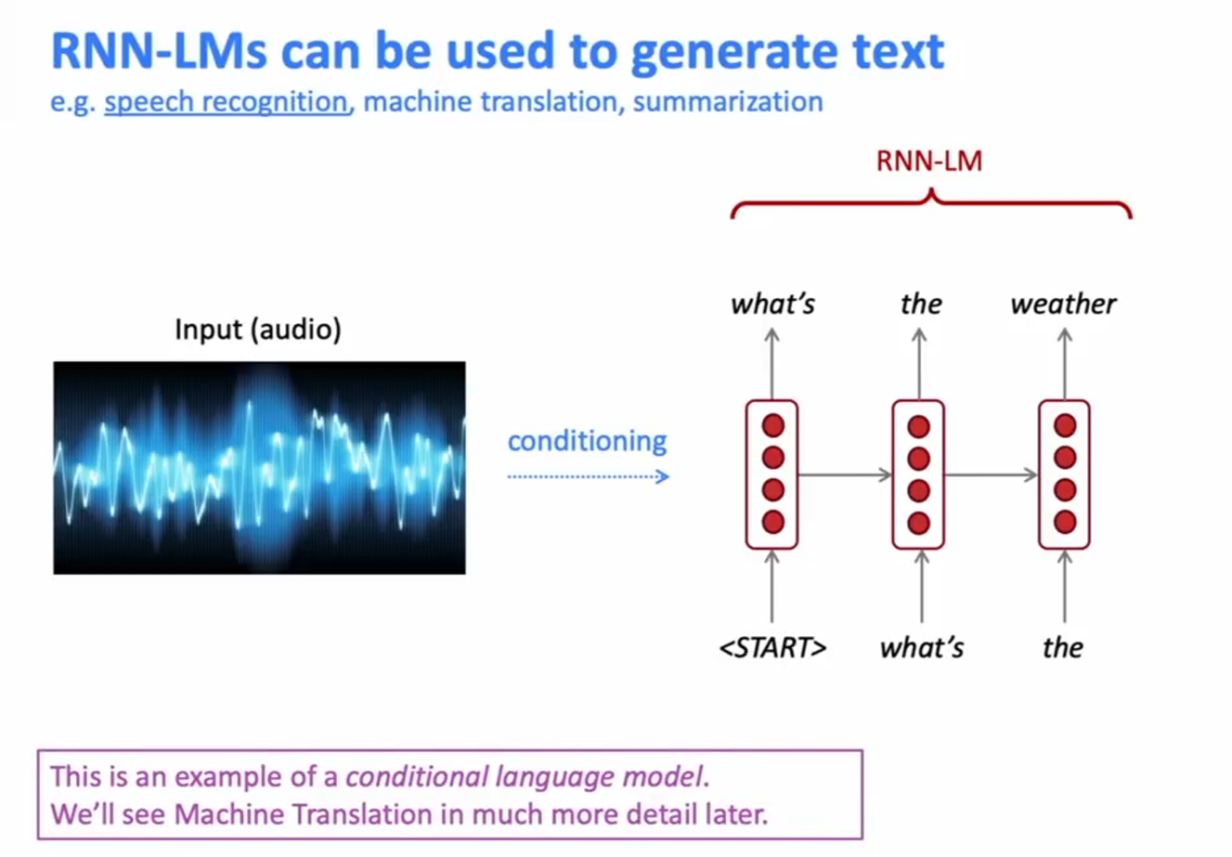
RNN – Other Use Cases – Beyond Language Modelling

Slide 41
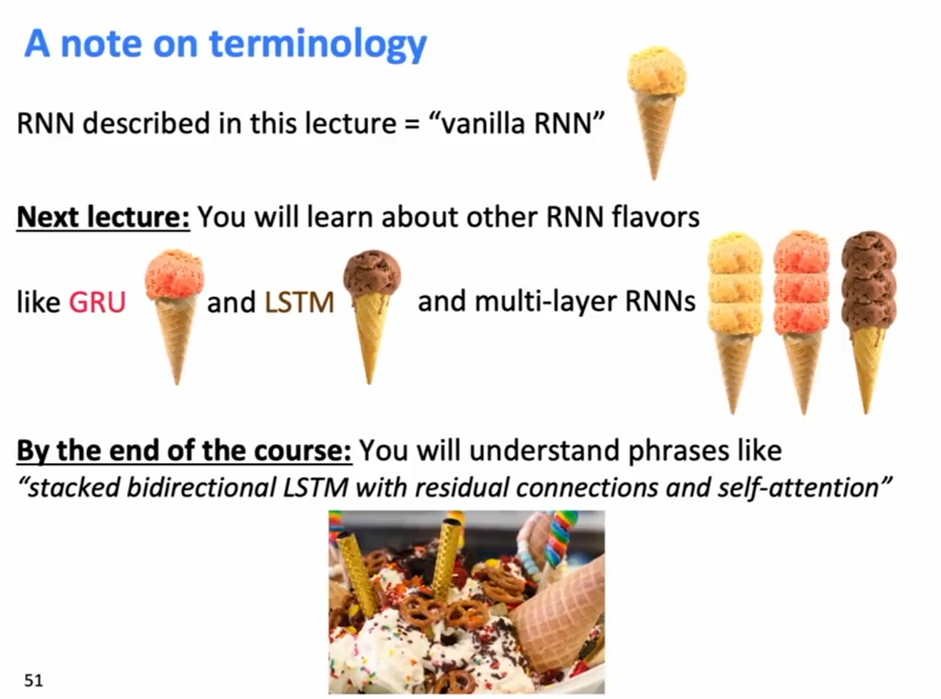
A note on terminology

Slide 42
Vanishing Gradients, Fancy RNNs

Slide 43
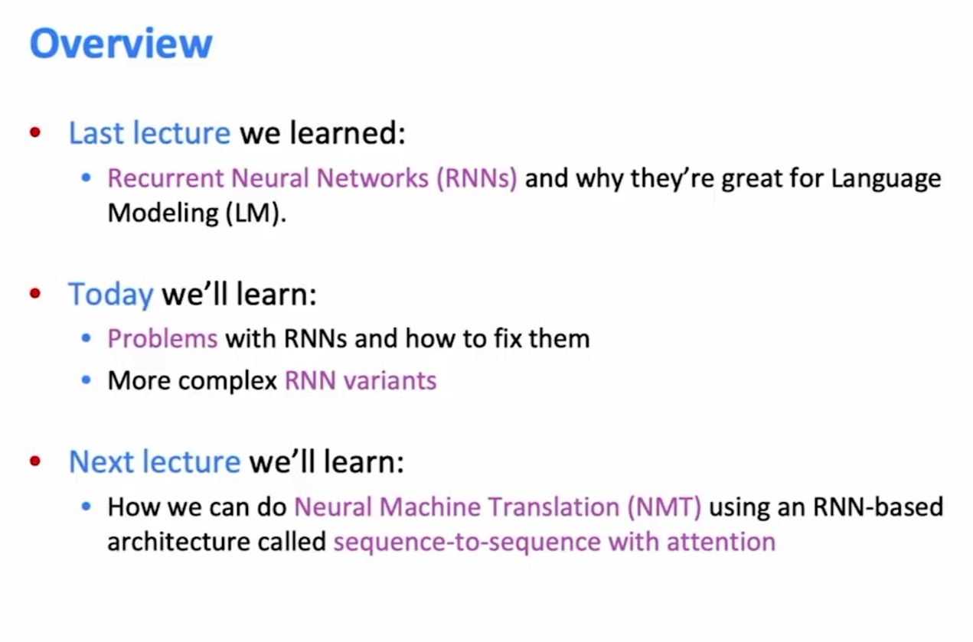
Overview

Slide 44


Slide 45

Vanishing gradient intuition

Slide 46



Vanishing gradient intuition
(Decomposing the gradient into products of intermediate gradients)

Slide 47

Vanishing gradient intuition

Slide 48

Vanishing gradient intuition

Slide 49

Vanishing gradient proof sketch – More formal definition

Slide 50

Vanishing gradient proof sketch – More formal definition

Slide 51

Why is vanishing gradient a problem ?

Slide 52

Why is vanishing gradient a problem ?

Slide 53

Effect of vanishing gradient on RNN-LM

Slide 54

Effect of vanishing gradient on RNN-LM

Slide 55

Why is “exploding” gradient a problem?

Slide 56

Gradient clipping: solution for exploding gradient

Slide 57

Gradient clipping: solution for exploding gradient

Slide 58

How to fix vanishing gradient problem ?

Slide 59

Long Short-Term Memory (LSTM)

Slide 60

Long Short-Term Memory (LSTM)

Slide 61


Long Short-Term Memory (LSTM)

Slide 62

How does LSTM solve vanishing gradients?

Slide 63

LSTMs: real-world success

Slide 64

Gated Recurrent Units (GRU)

Slide 65

LSTM Vs GRU

Slide 66



Is vanishing/exploding gradient just a RNN problem ?

Slide 67

Is vanishing/exploding gradient just a RNN problem ?

Slide 68

Recap

Slide 69

Bidirectional RNNs: Motivation

Slide 70

Bidirectional RNNs

Slide 71

Bidirectional RNNs

Slide 72

Bidirectional RNNs: simplified diagram

Slide 73

Bidirectional RNNs

Slide 74

Multi-Layer RNNs

Slide 75

Multi-Layer RNNs

Slide 76

Multi-layer RNNs in practice

Slide 77

In summary

Slide 78
Subword Models

Slide 79

Morphology : Parts of words

Slide 80

Morphology: Character n-grams

Slide 81

FastText embeddings

Slide 82

FastText embeddings

Slide 83

FastText embeddings

